Slide 1
Ditch No. 2149 Melody Lane Storm
Single County Ditch Petition
Village of Delta, Ohio
November 22, 2022

Slide 2
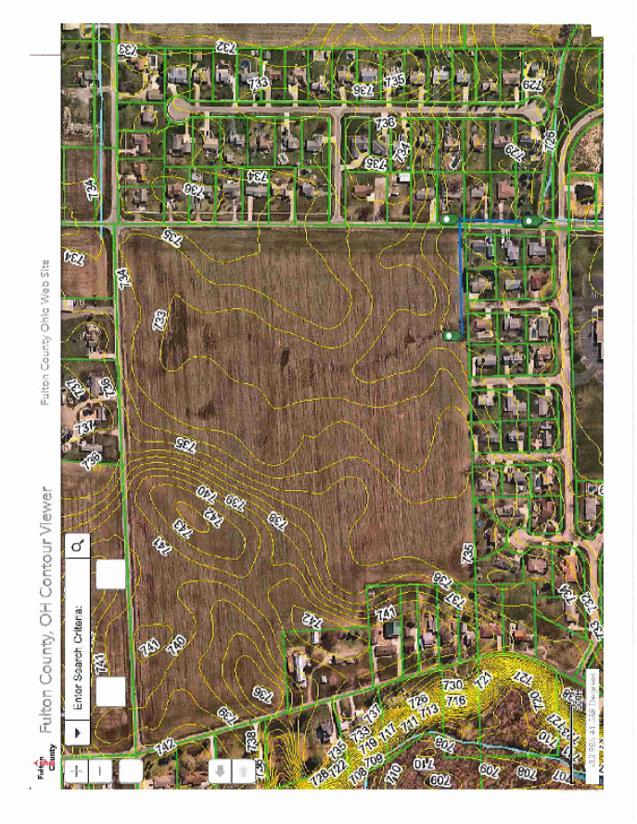

Slide 3
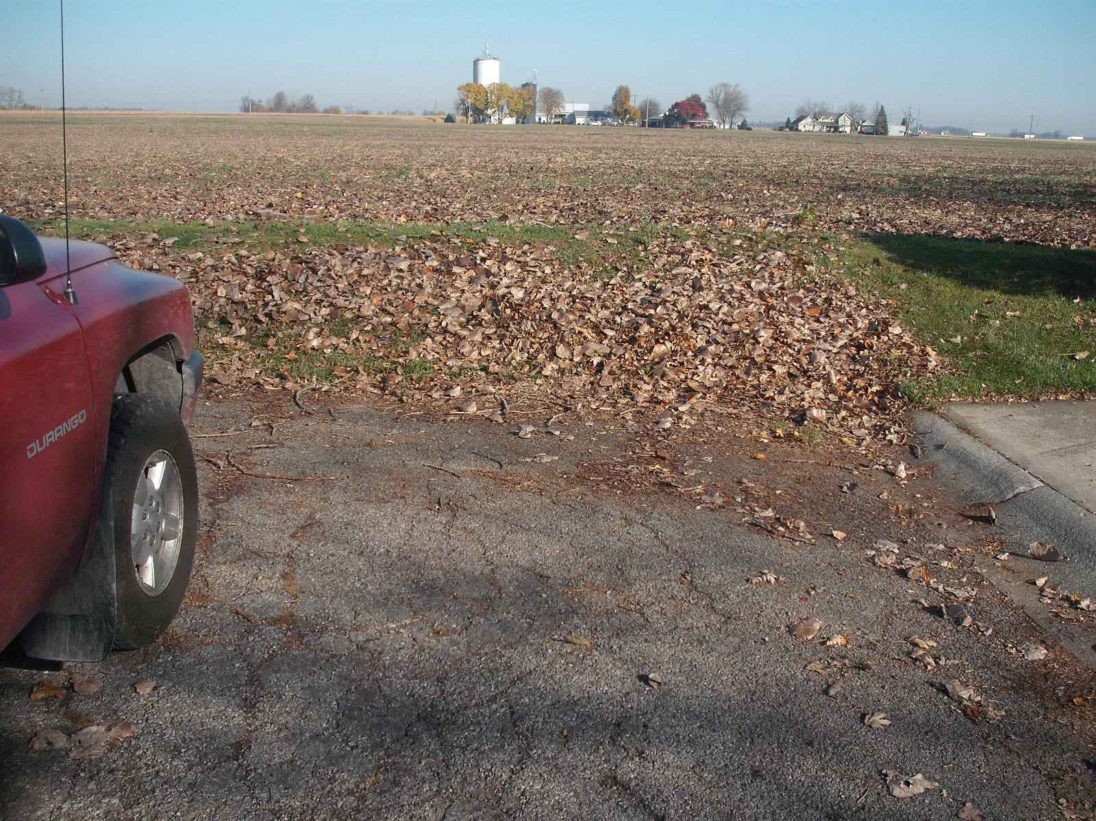
North end Harvest Lane –
Embankment at the end of the street

Slide 4
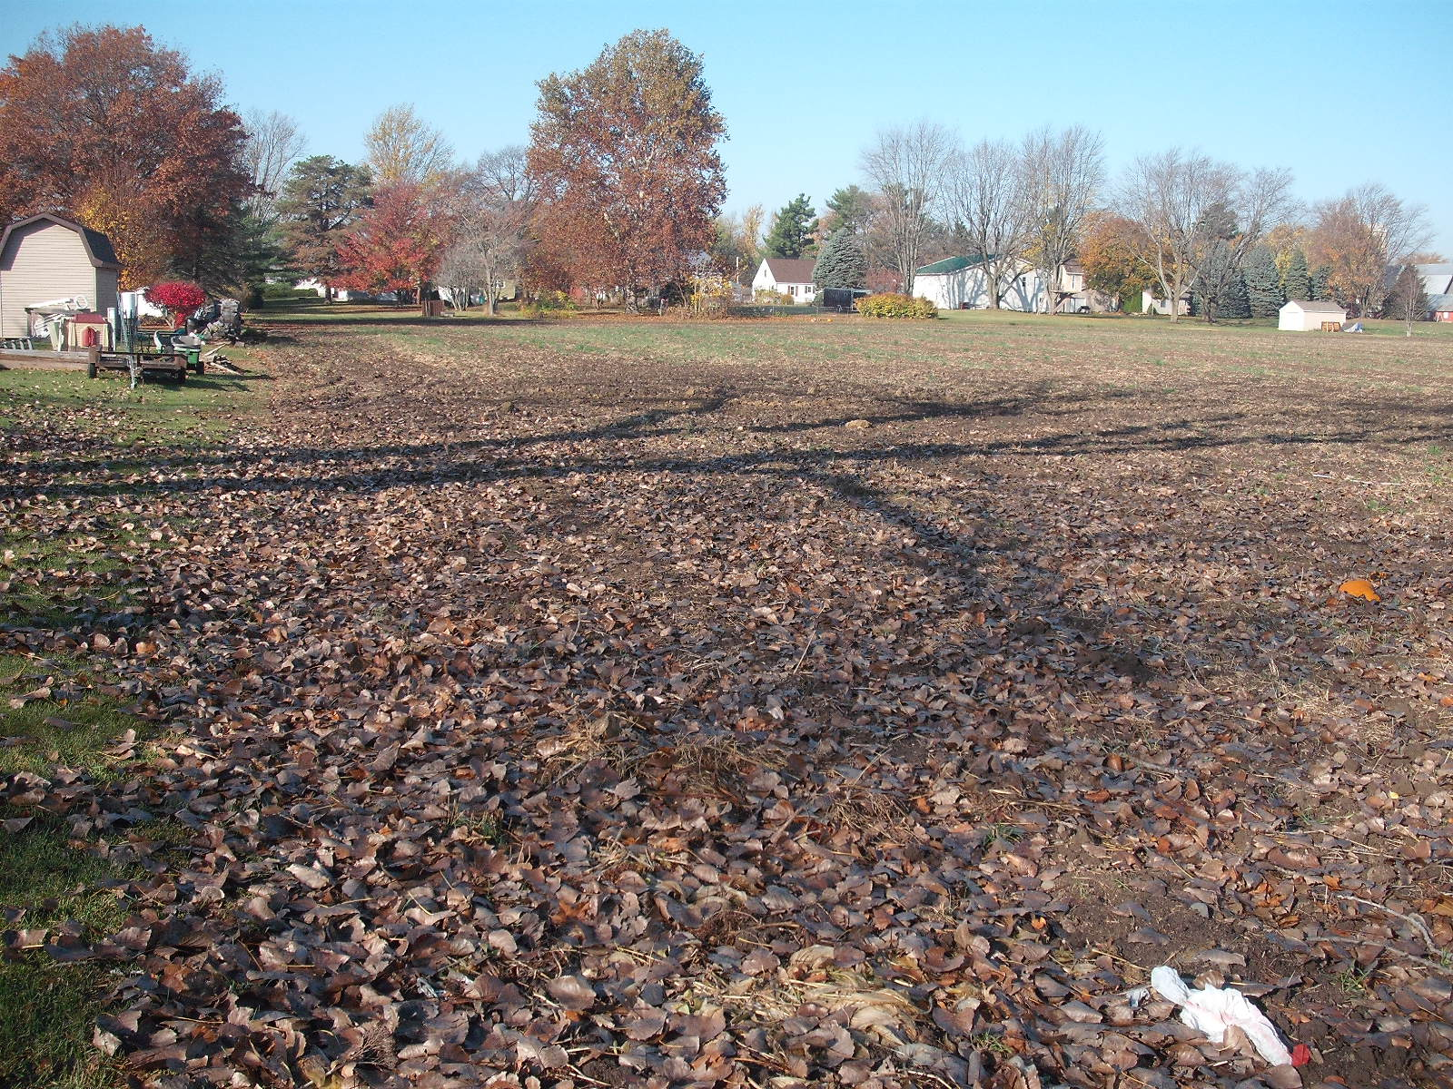
North end Harvest Lane –
Upstream to the West

Slide 5
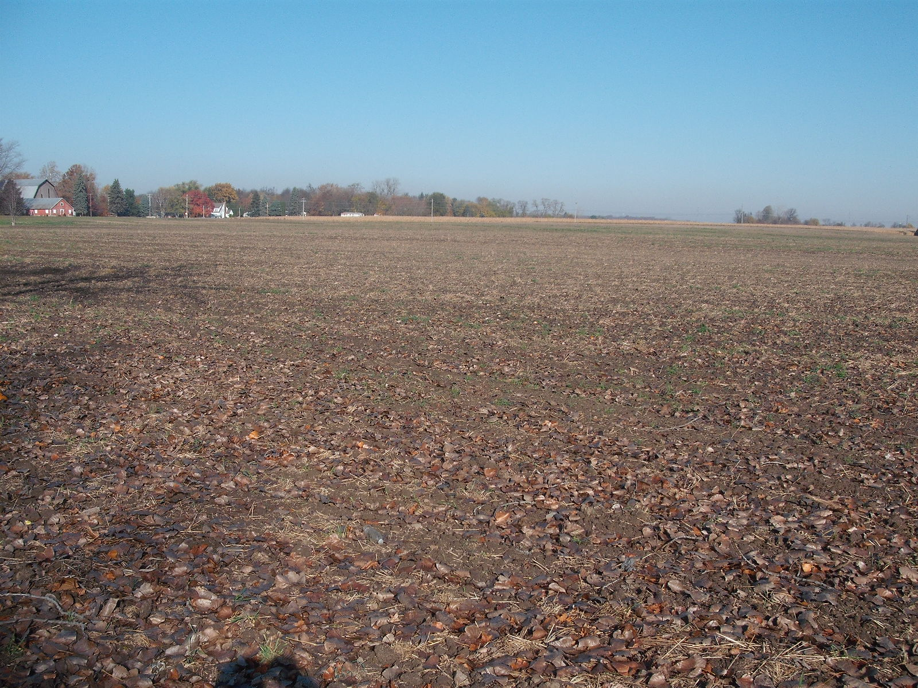
North end Harvest Lane –
Upstream to the Northwest

Slide 6
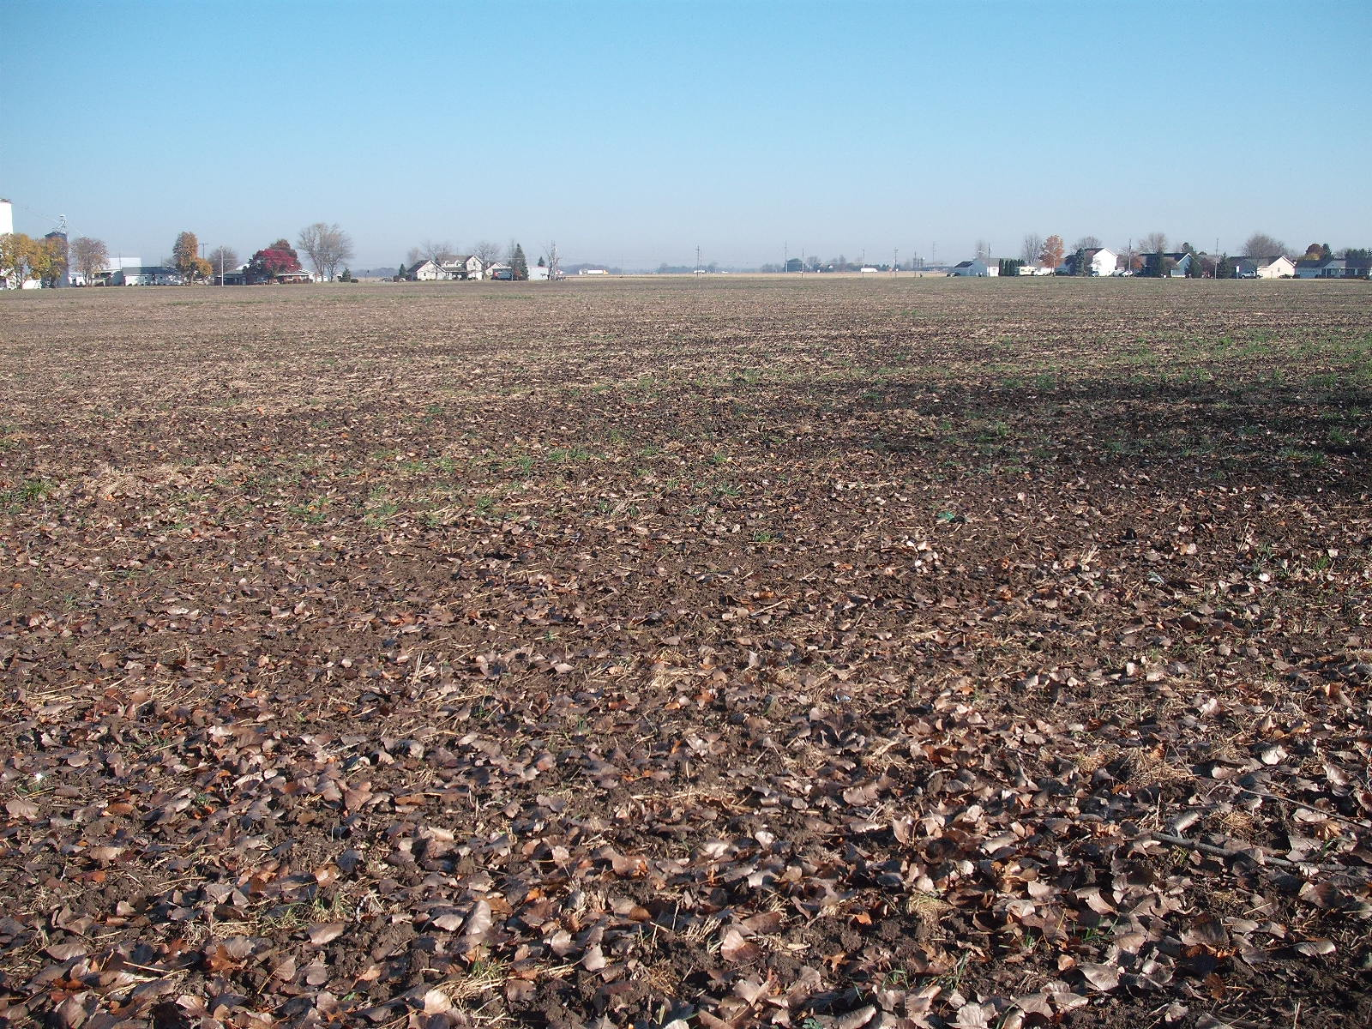
North end Harvest Lane –
Upstream to the Northeast

Slide 7
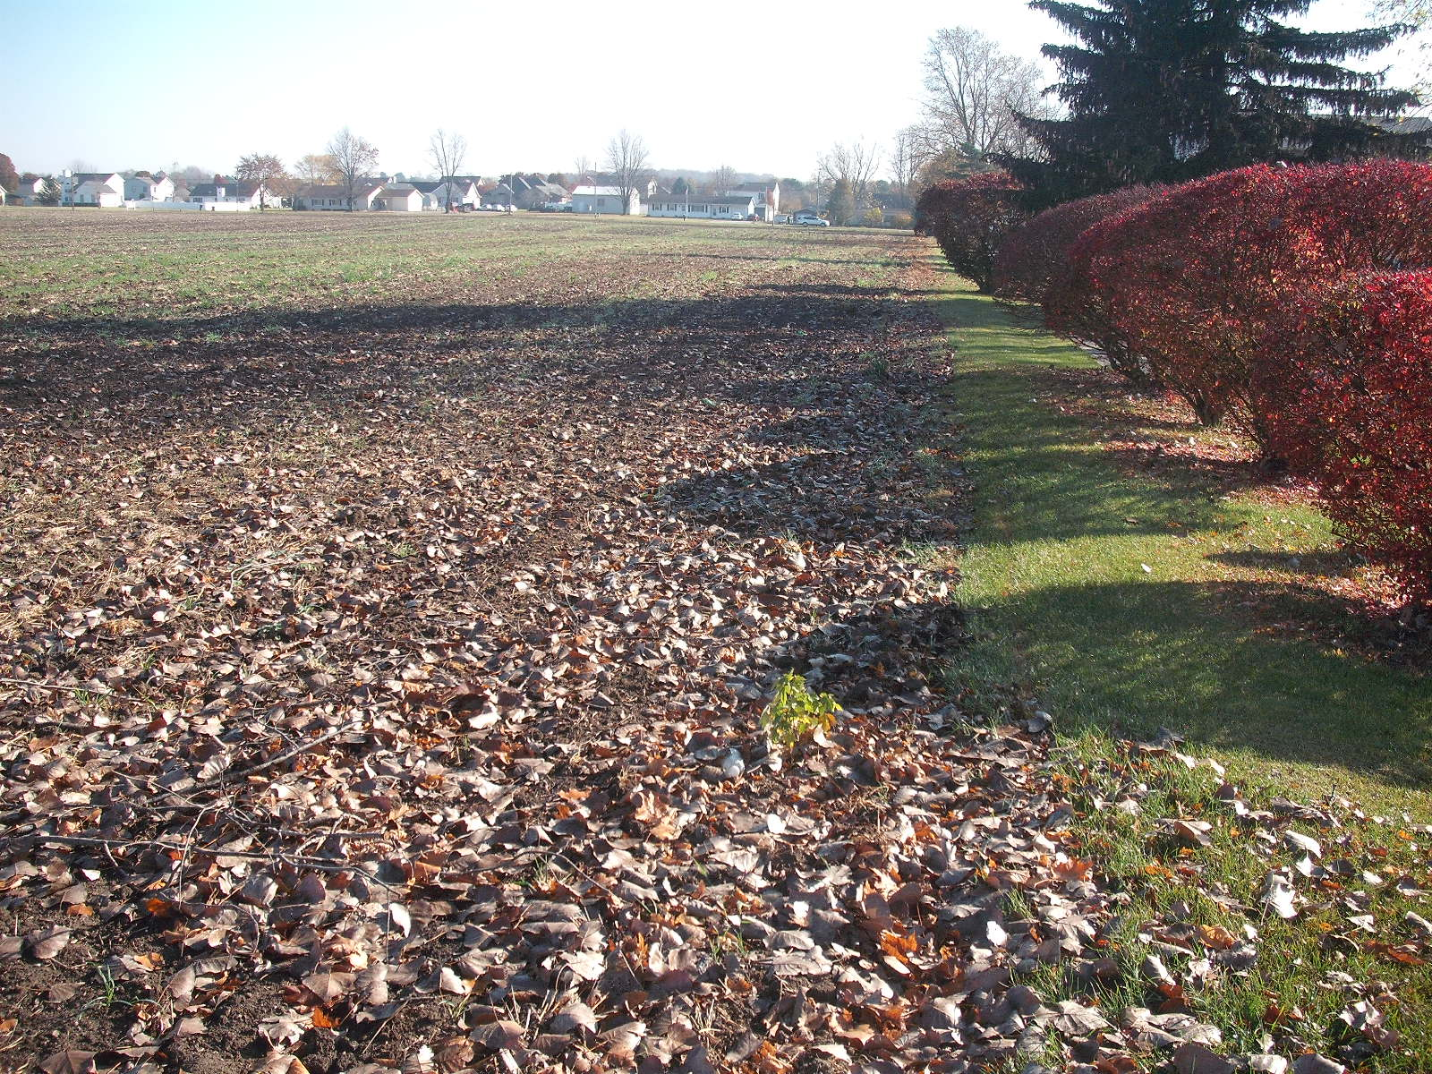
North end Harvest Lane –
Downstream to the East

Slide 8
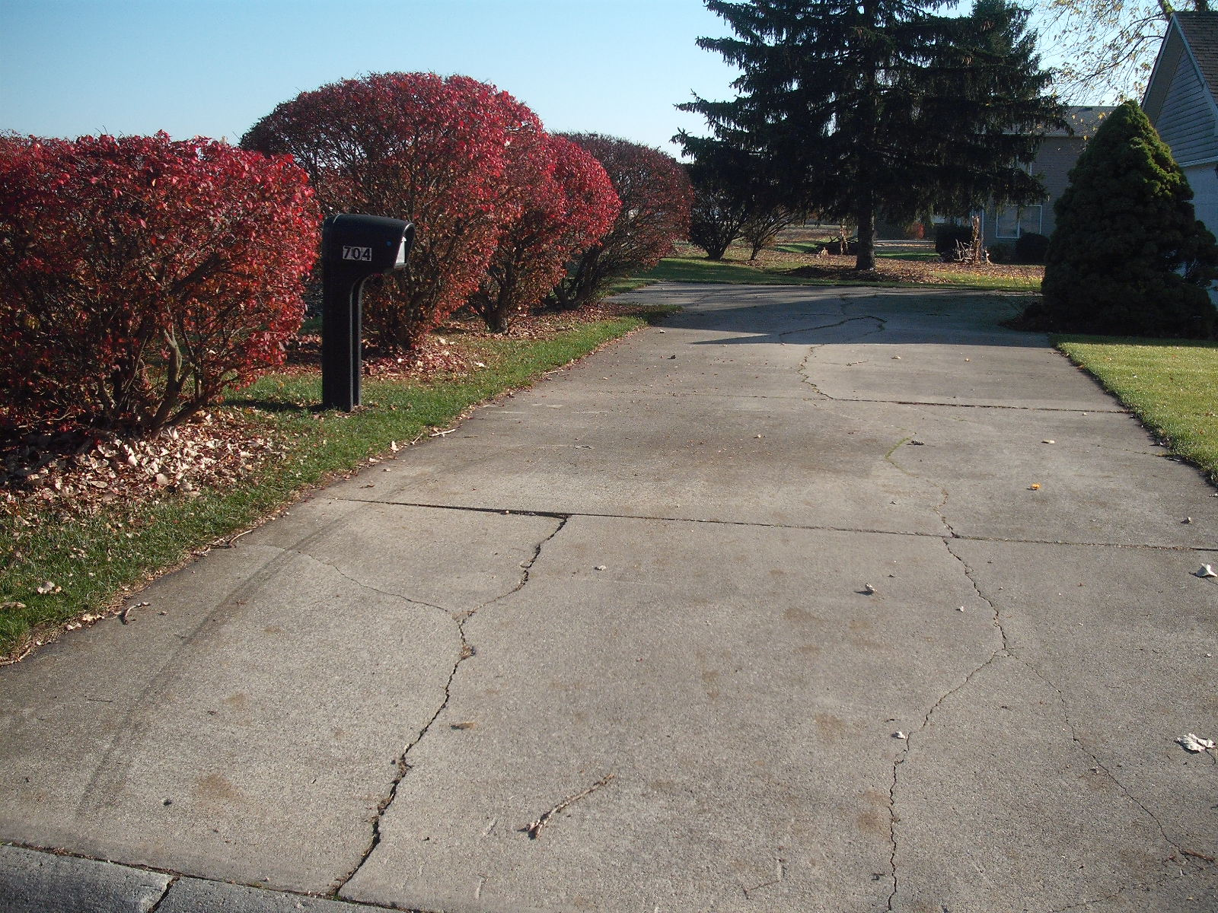
North end Harvest Lane –
Embankment downstream along house lots

Slide 9
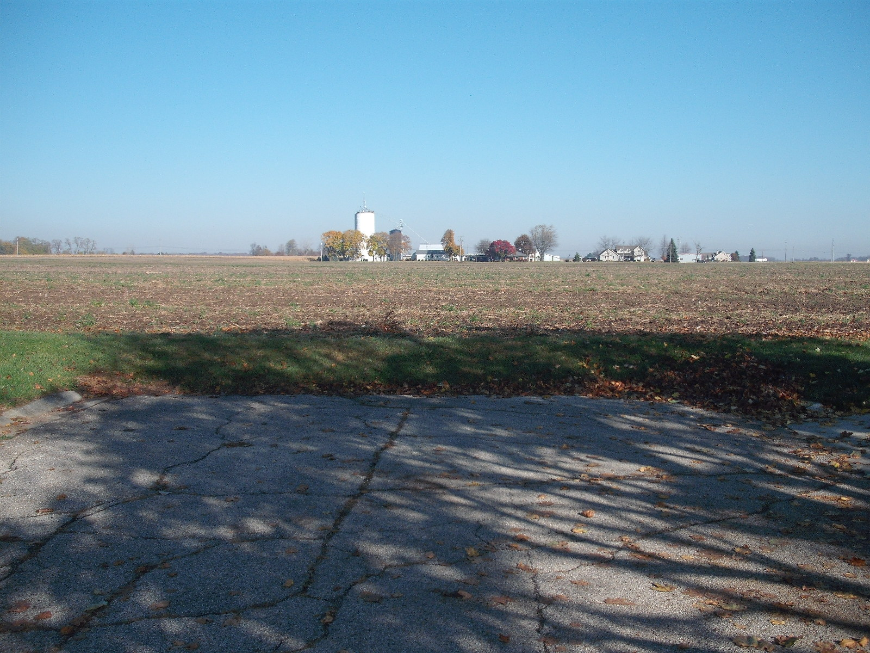
North end Holly Lane –
Embankment at the end of the street

Slide 10
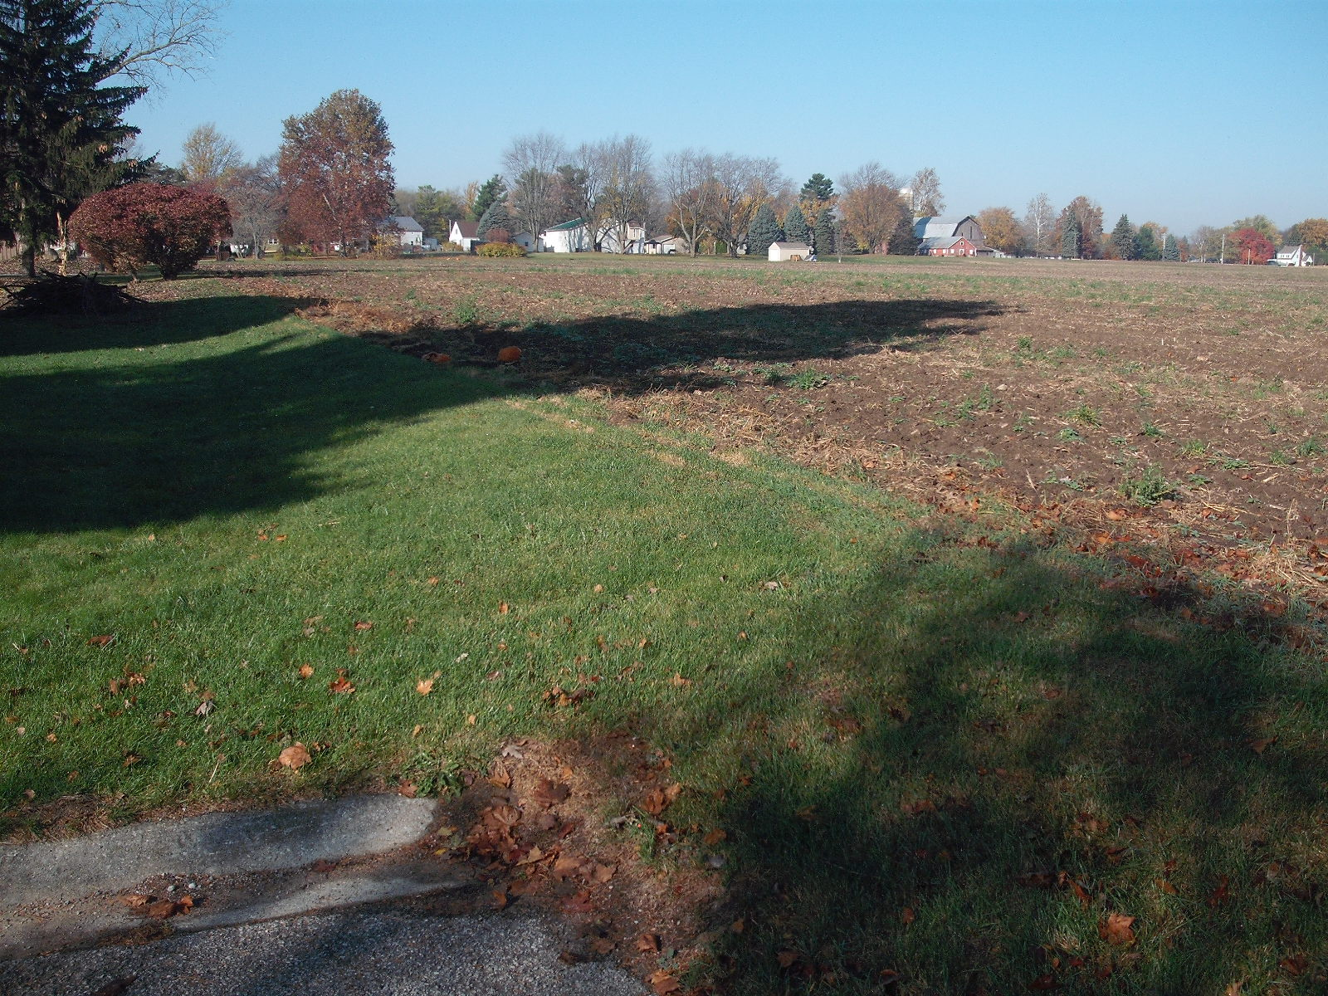
North end Holly St. –
Upstream to the West

Slide 11
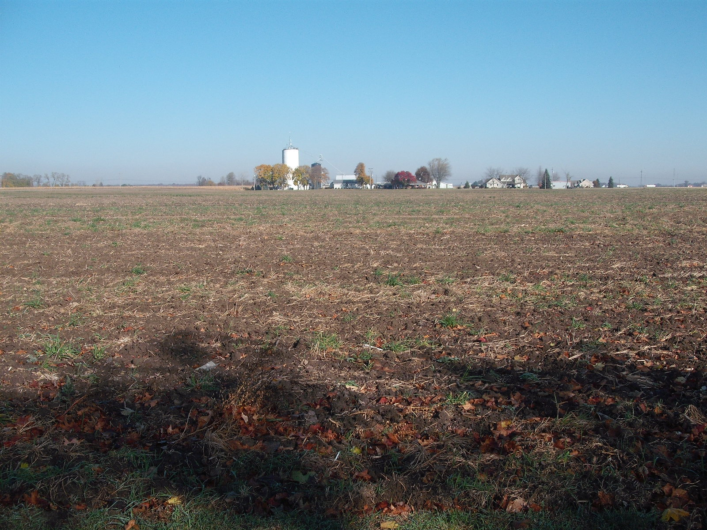
North end Holly Lane –
Upstream to the North

Slide 12
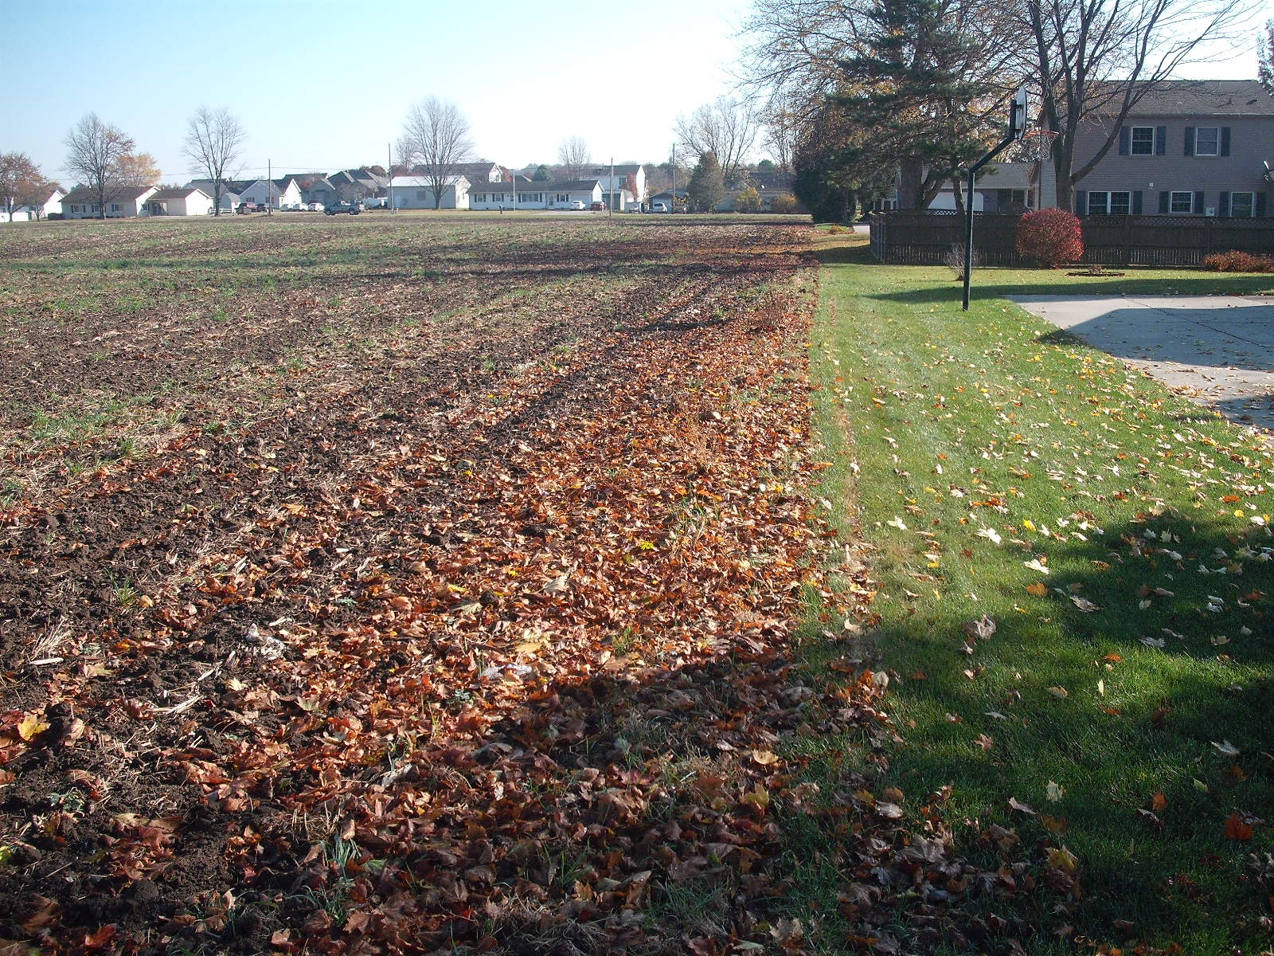
North end Holly Lane –
Downstream to the East

Slide 13
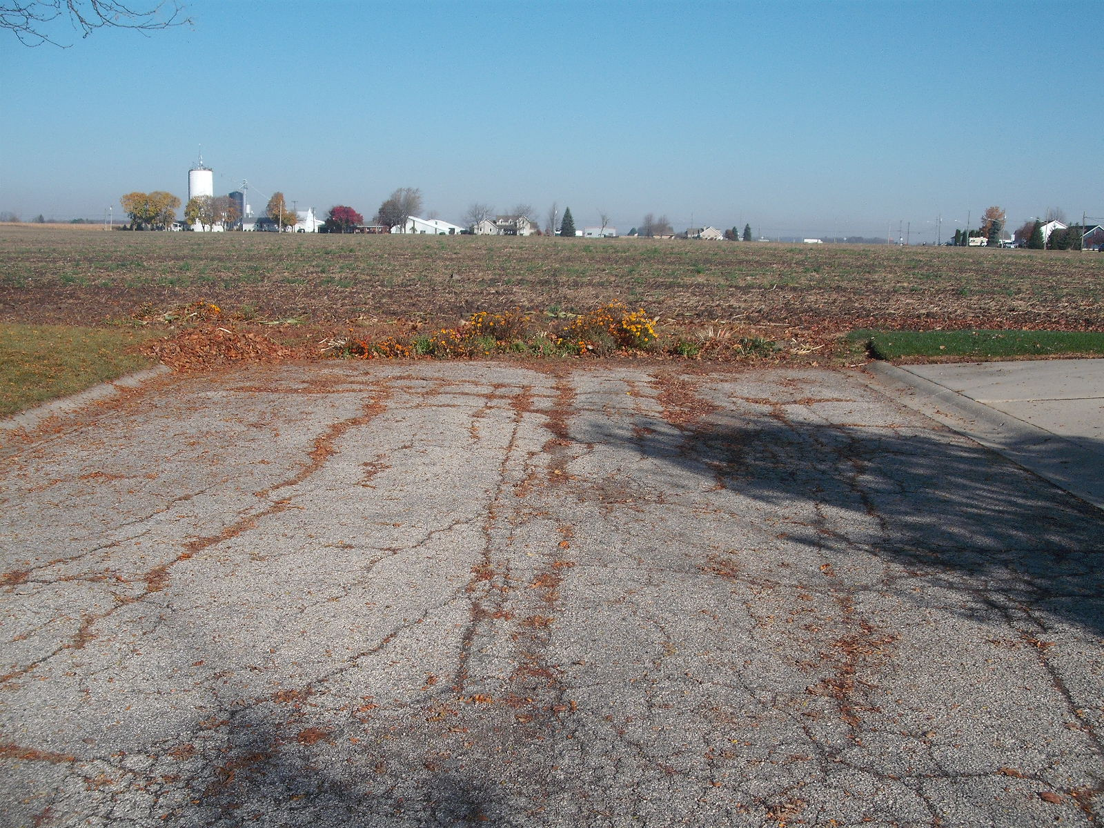
North end Melody Lane –
No embankment at the end of the street

Slide 14
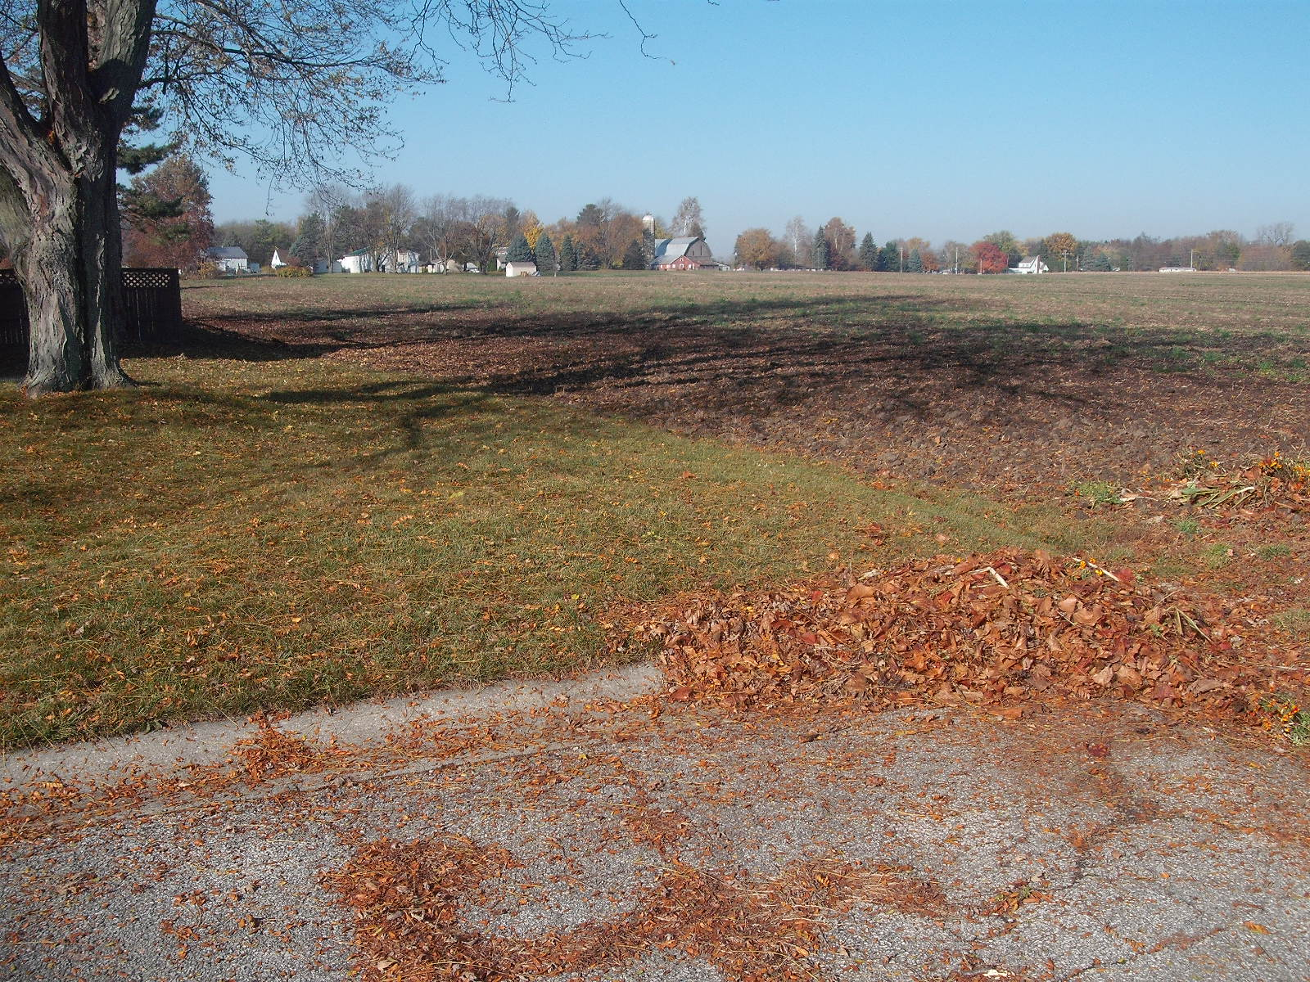
North end Melody Lane –
Upstream to the West

Slide 15
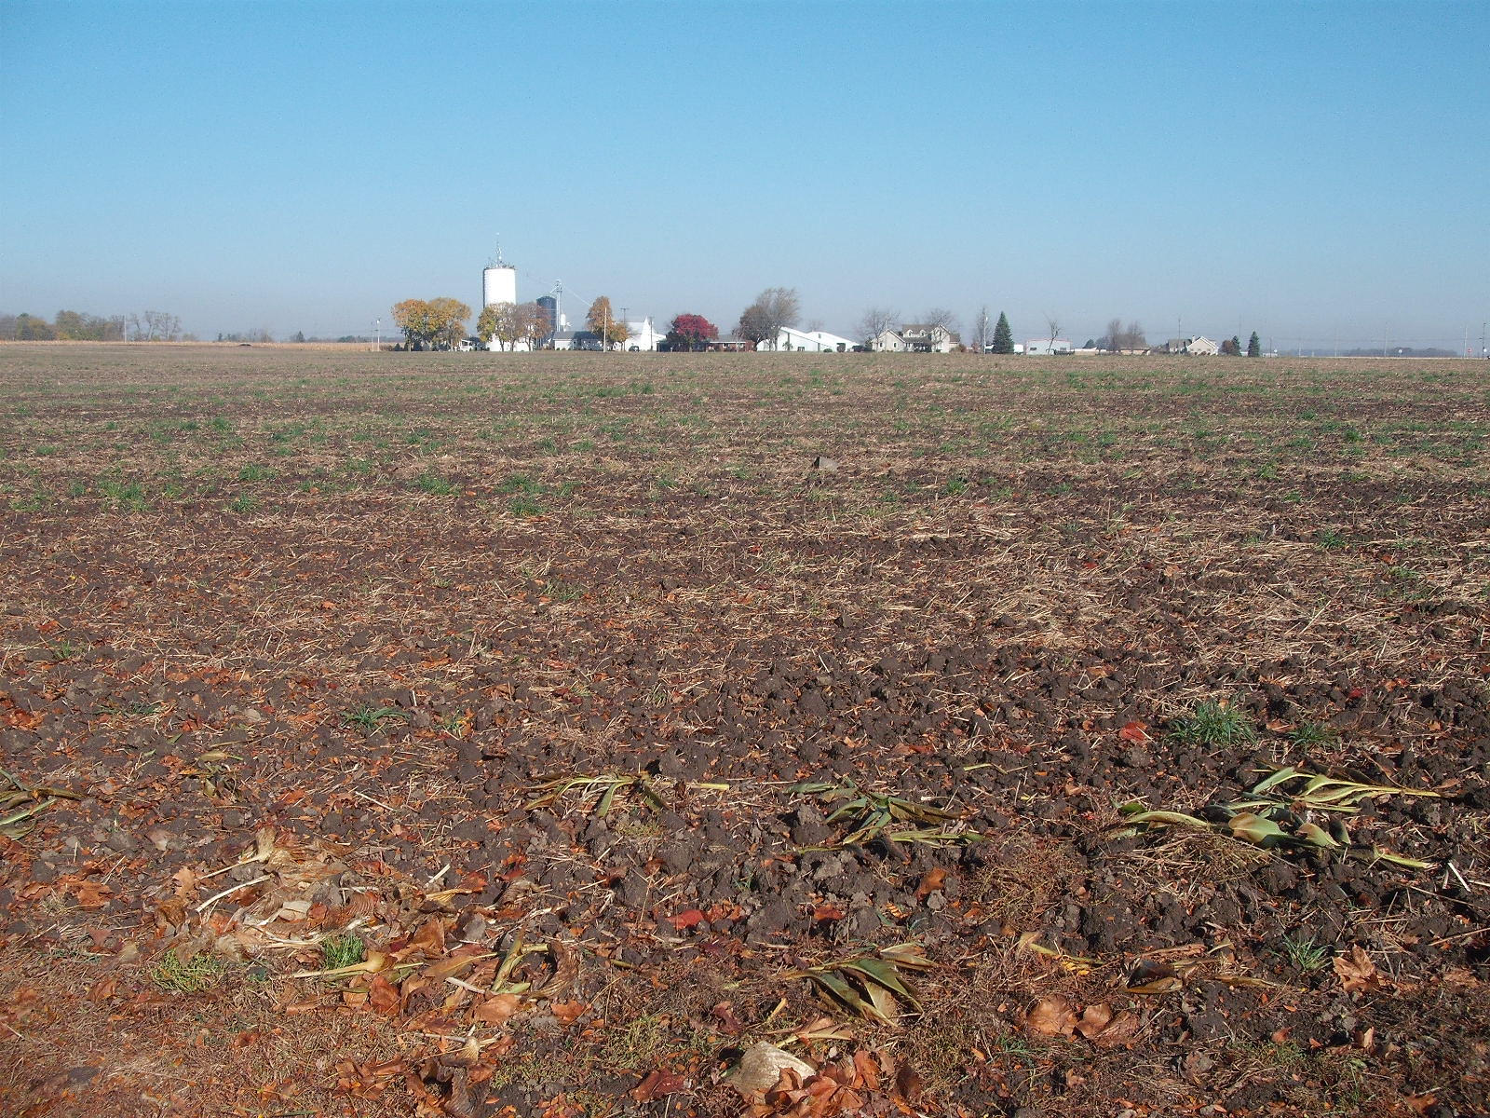
North end Melody Lane –
Upstream to the North

Slide 16
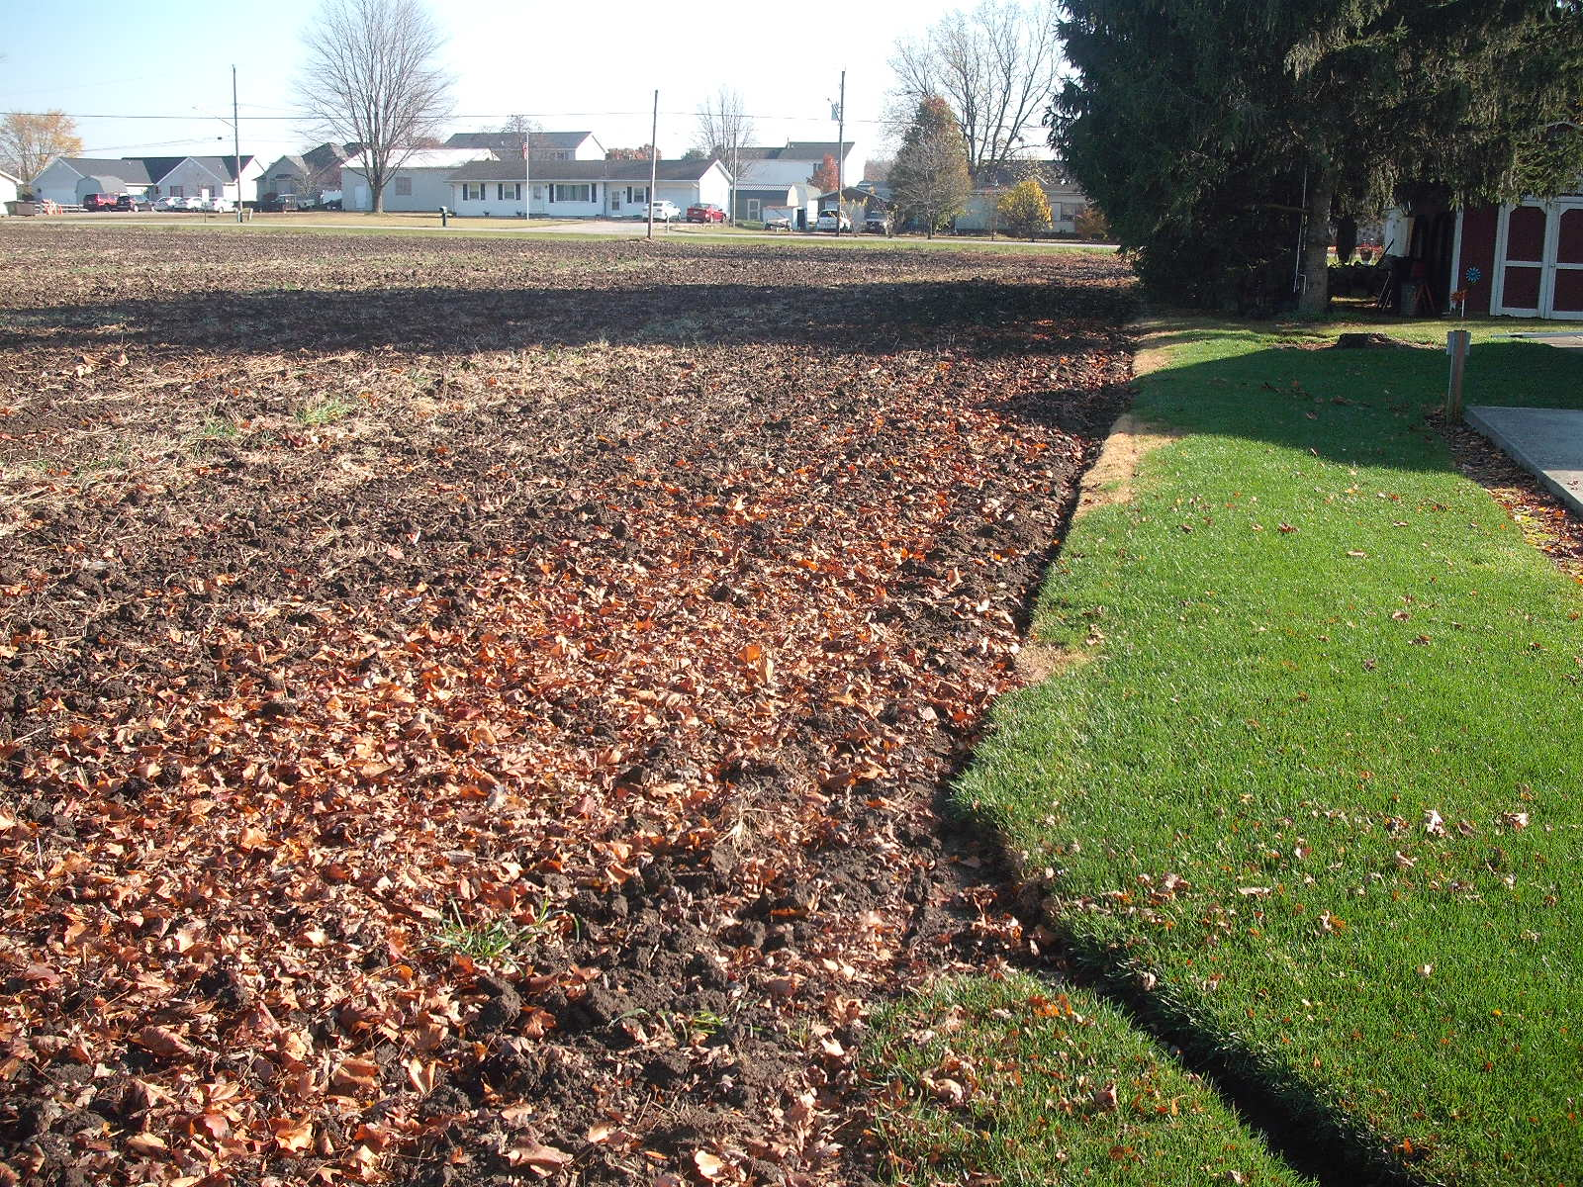
North end Melody Lane –
Downstream to the East

Slide 17
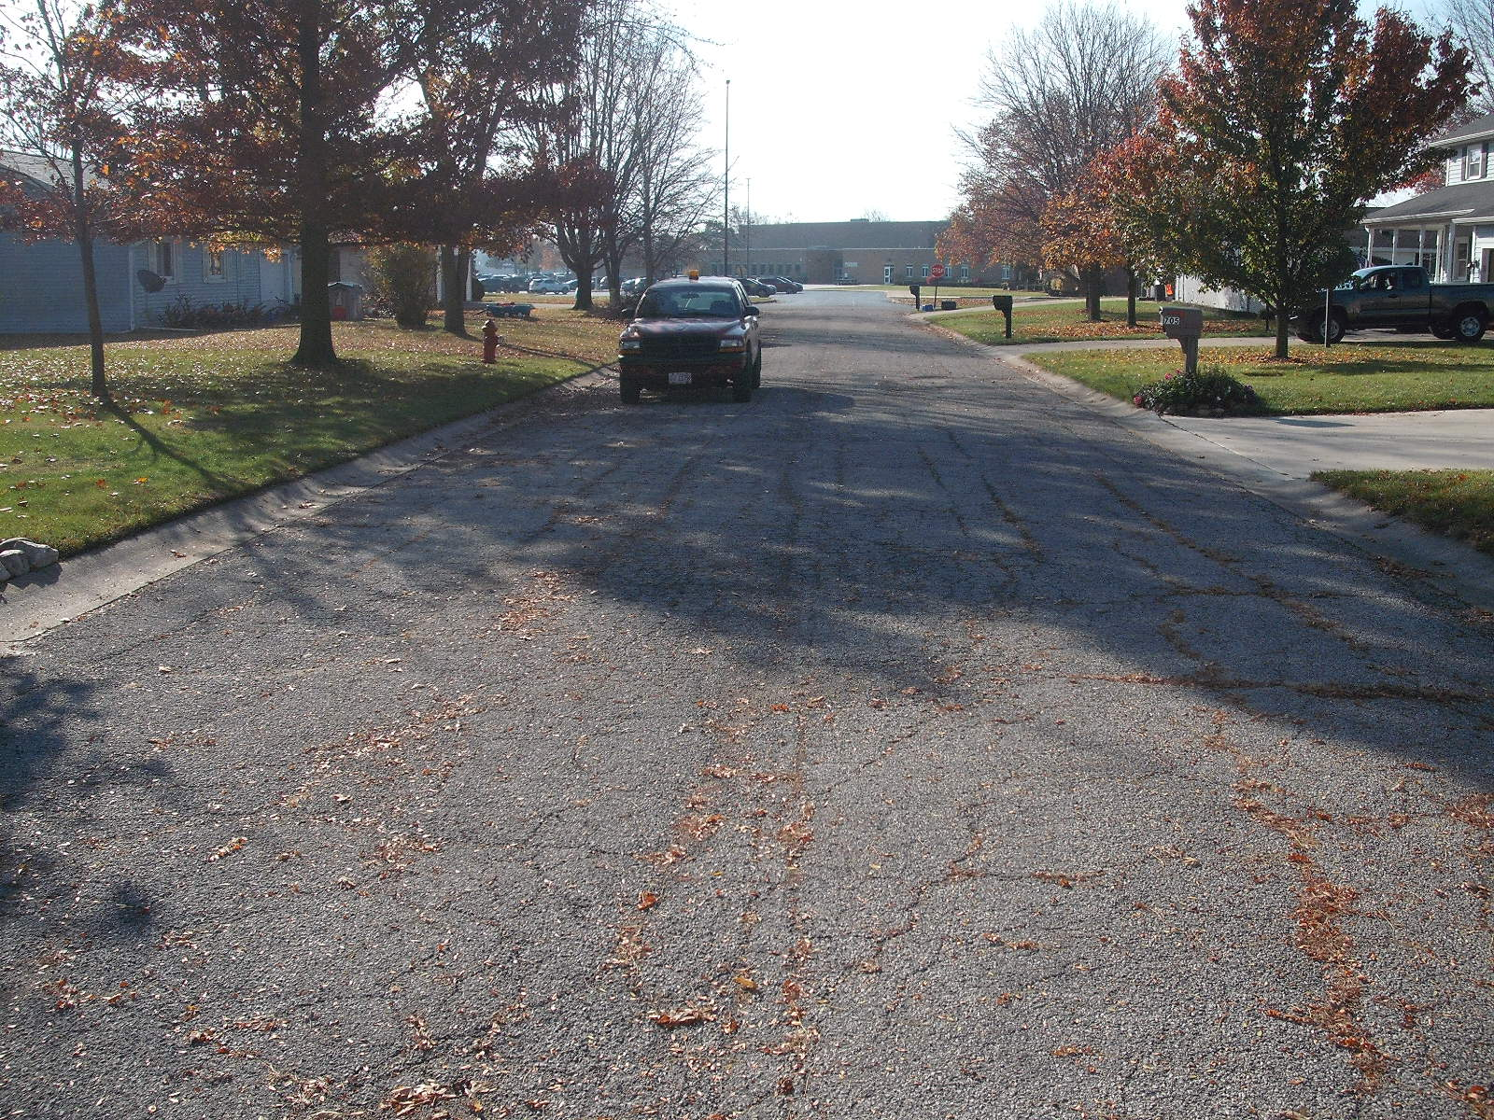
North end Melody Lane –
Downstream to the South down Melody Lane

Slide 18
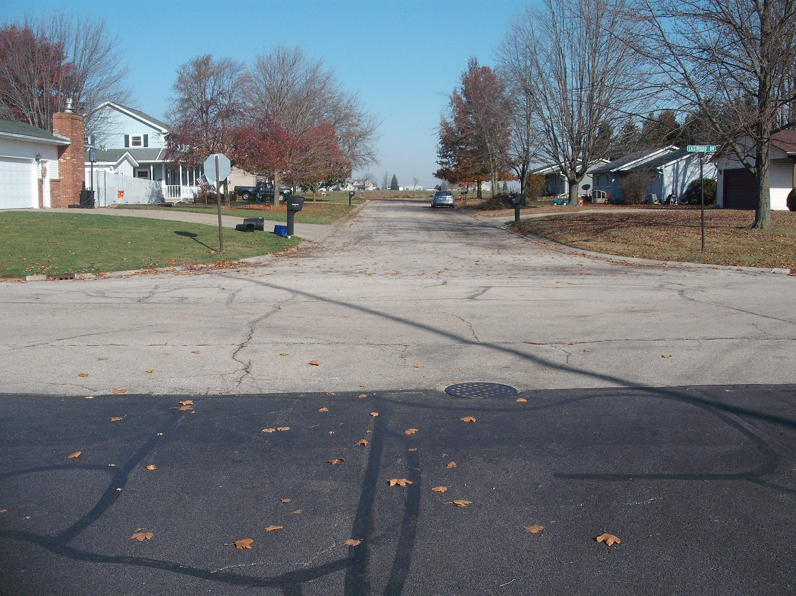
South end Melody Lane –
At Eastwood Drive and H.S. Parking Lot

Slide 19
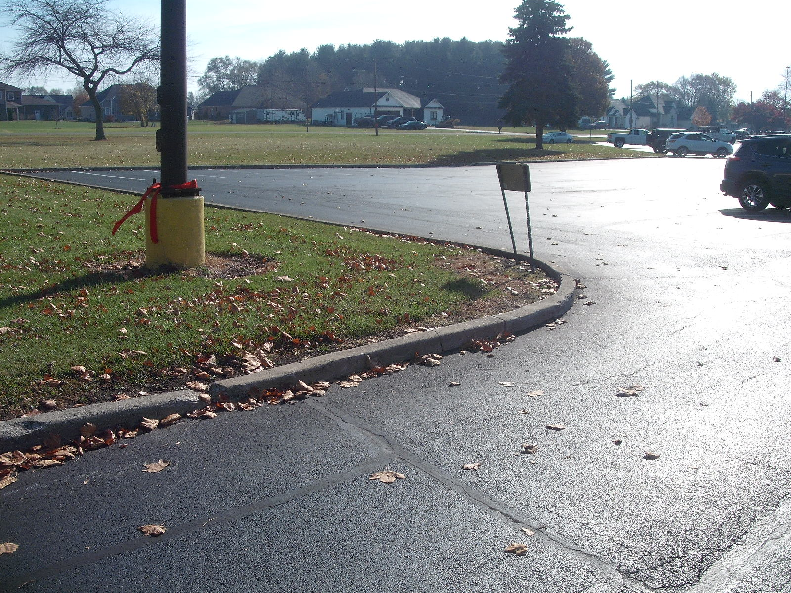
Delta High School Parking Lot

Slide 20
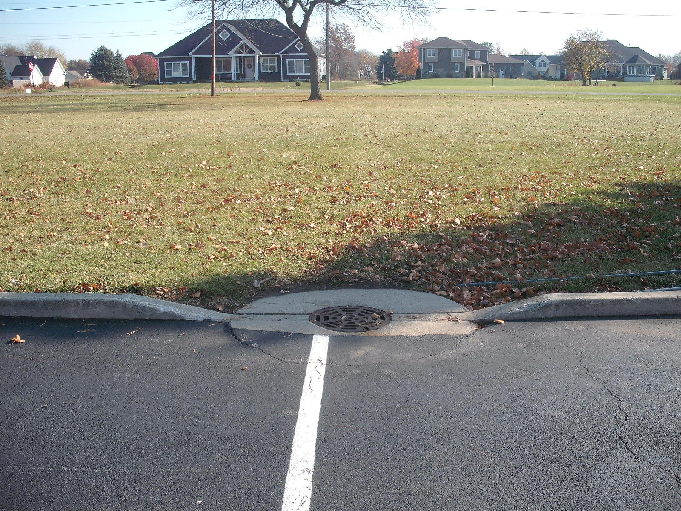
Catch Basin in H.S. Parking Lot
Outlets East to Fewless Creek along Taylor Street

Slide 21
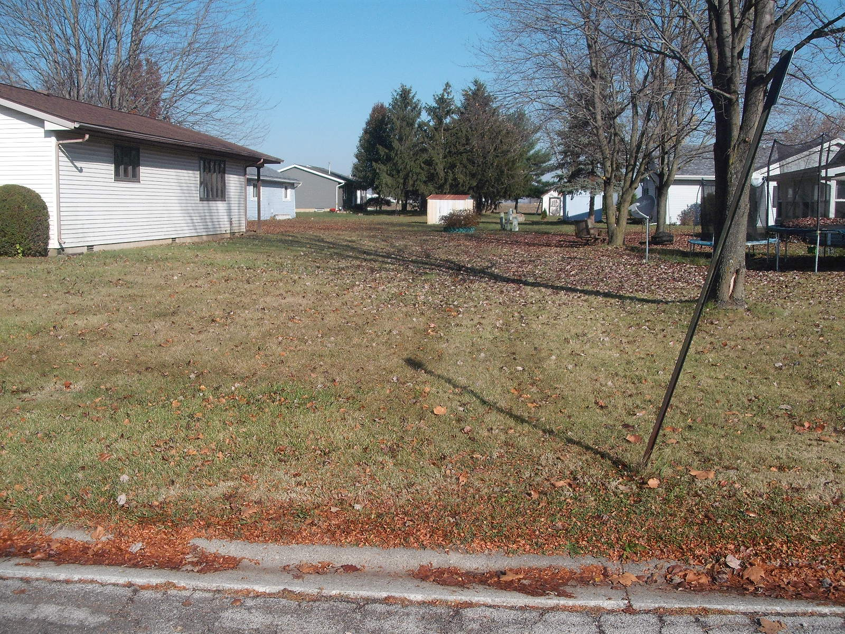
Rear of Lots between
Melody Lane and Taylor Street
Subject to occasional flooding

Slide 22
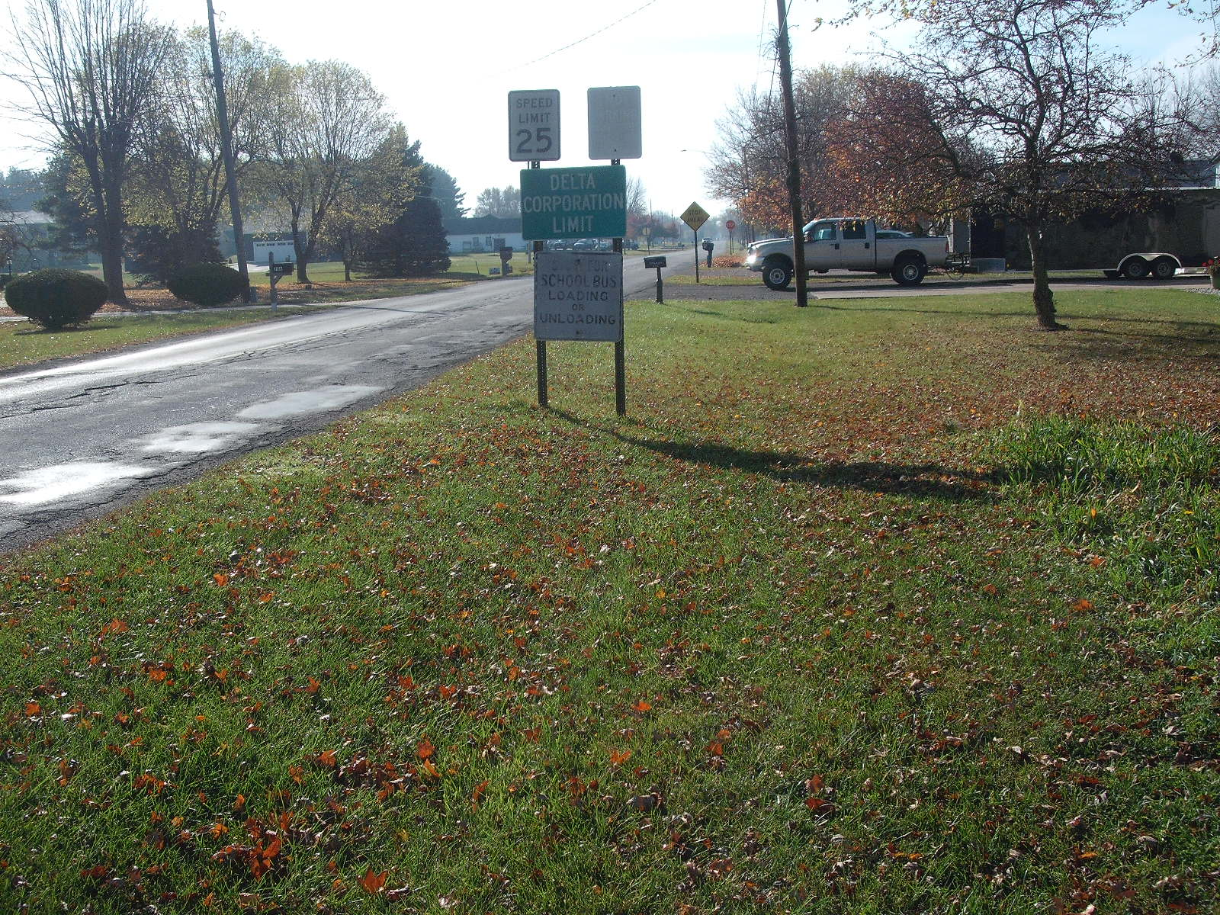
Taylor Street at the Village Limits

Slide 23
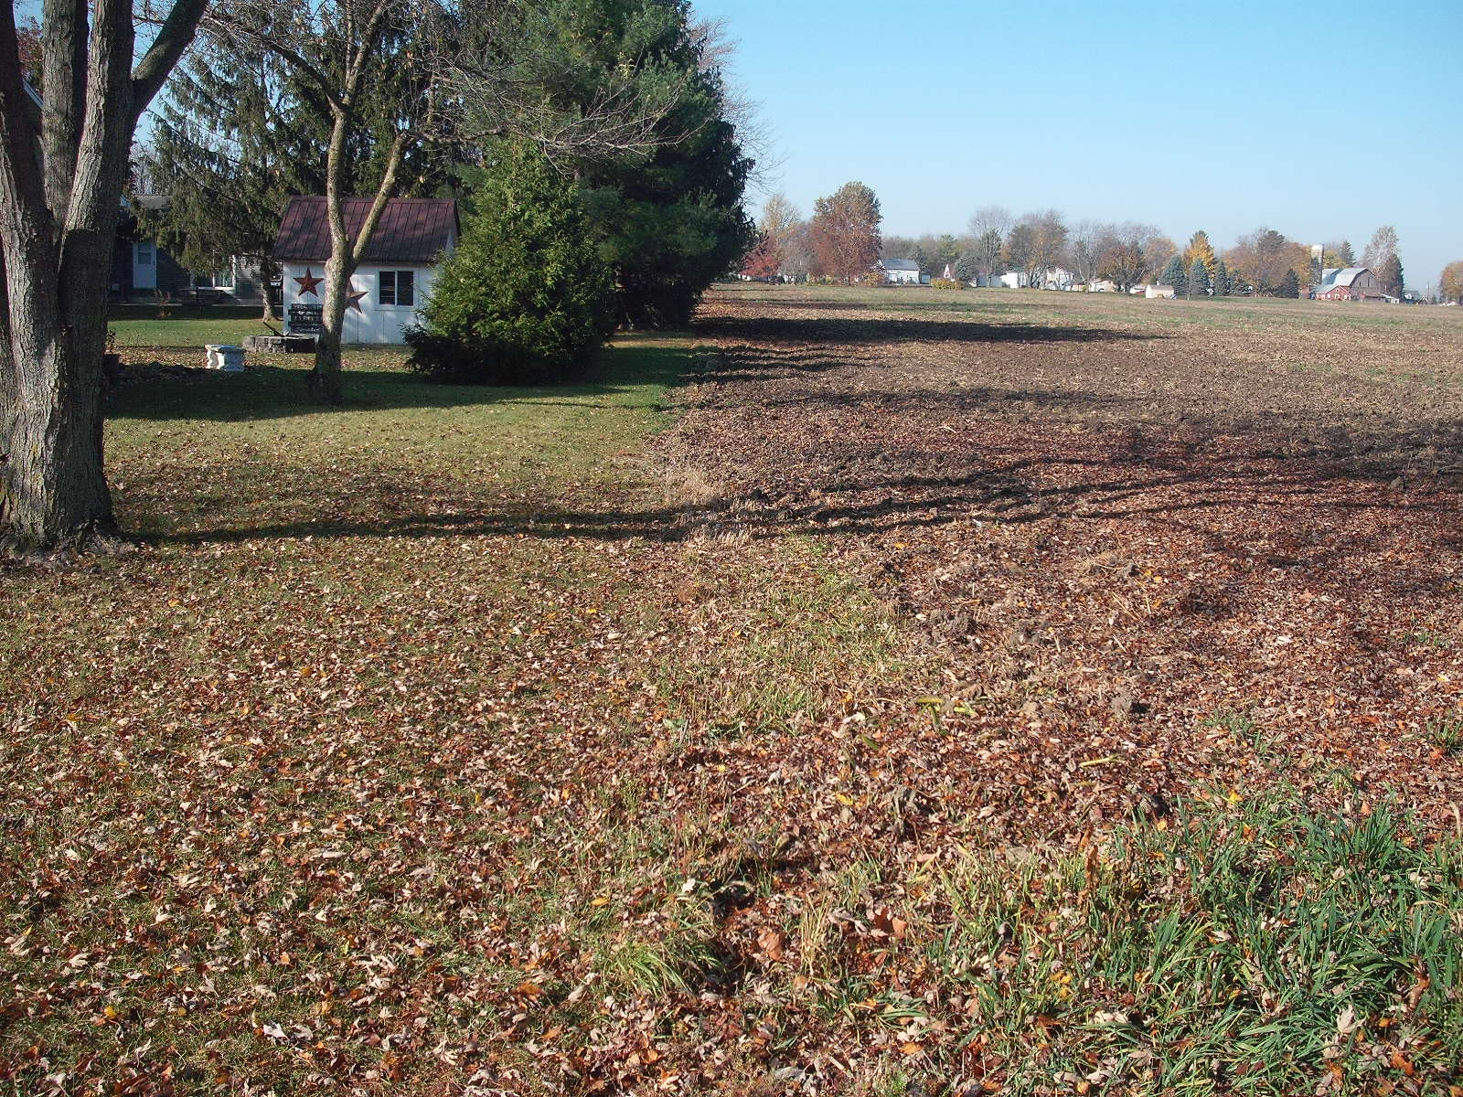
Taylor Street –
Upstream to the West

Slide 24
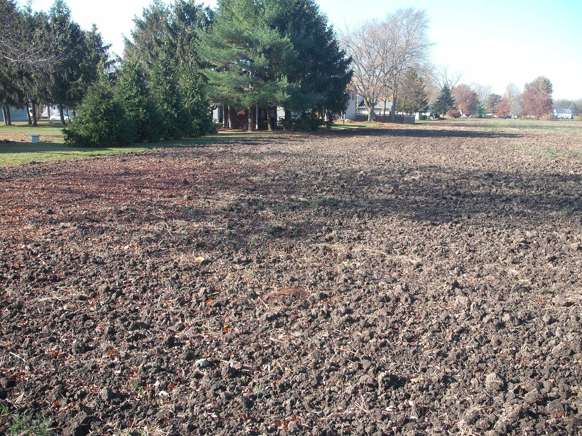
Taylor Street –
Upstream to the West

Slide 25
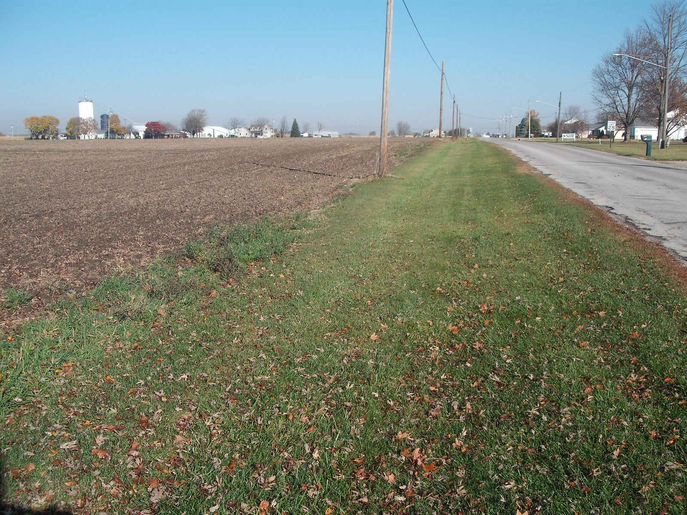
Taylor Street/County Road 7 –
Upstream to the North

Slide 26
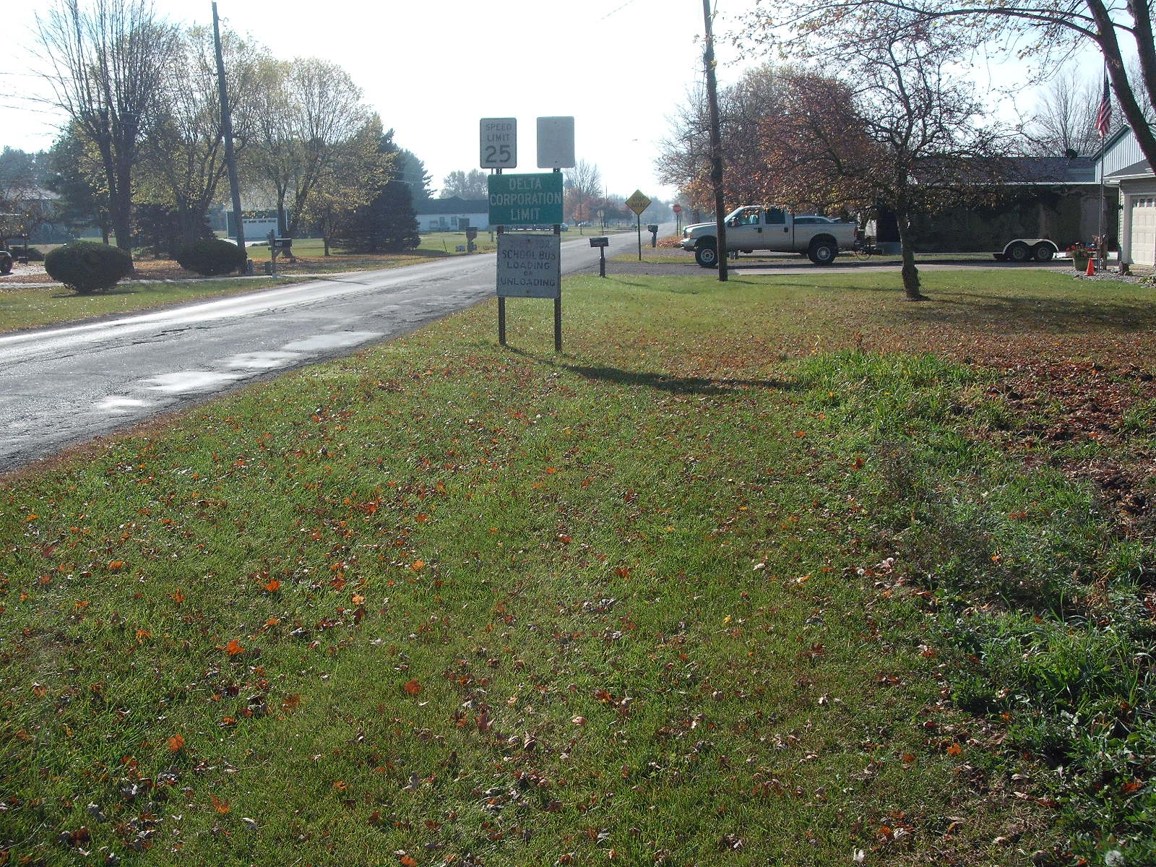
West side Taylor Street
Looking downstream

Slide 27
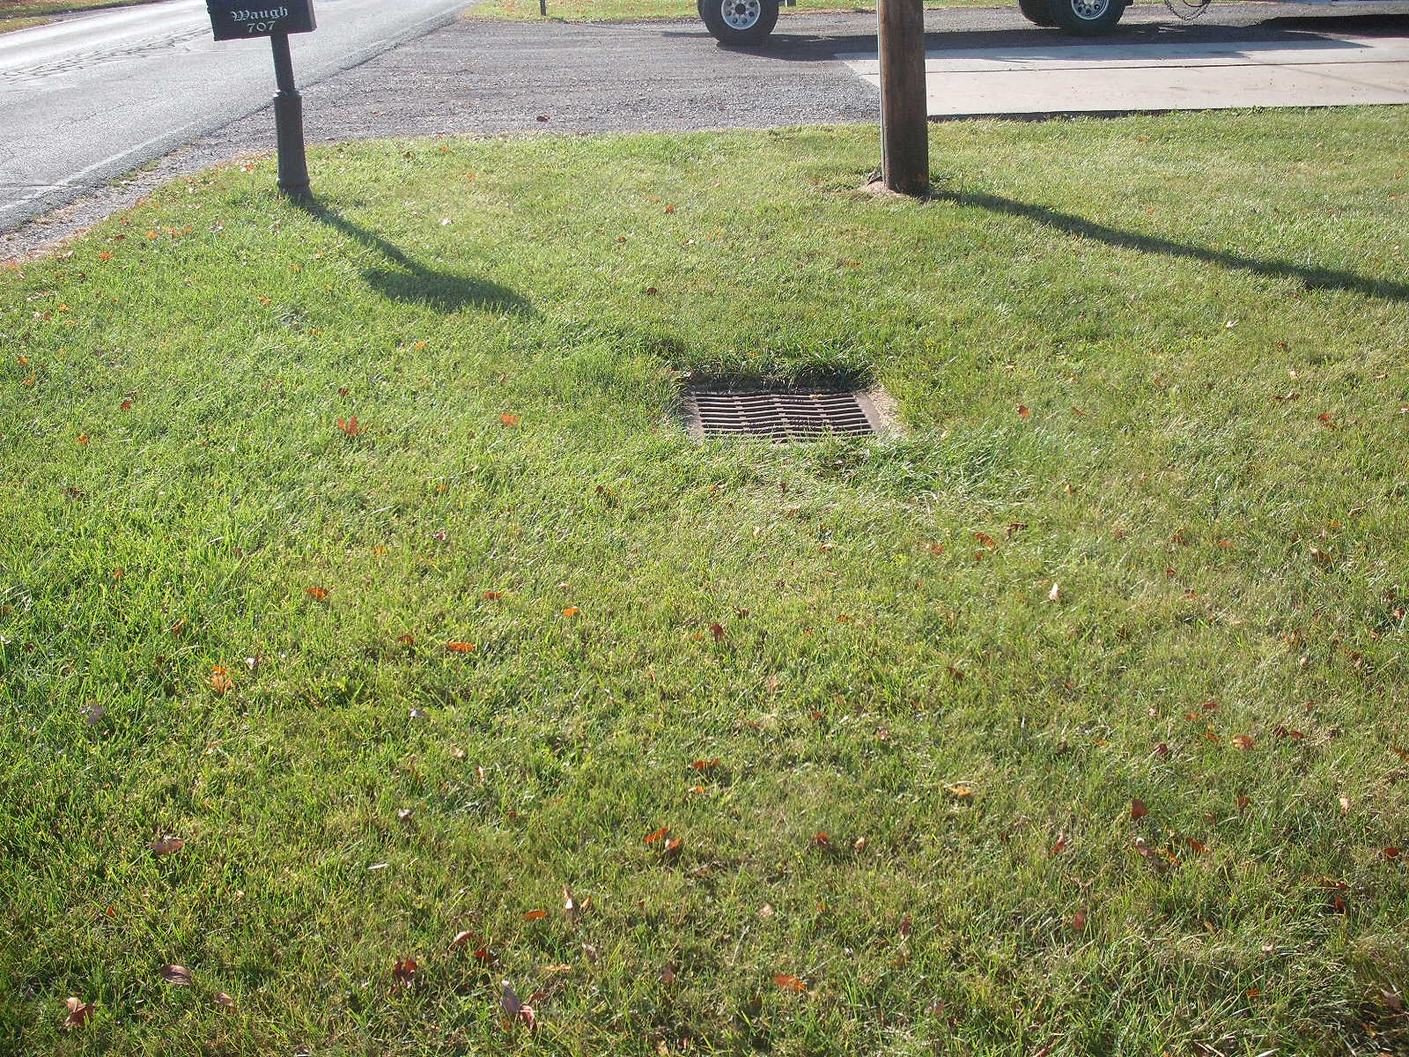
Catch Basin west side Taylor Street
Existing Surface Water Outlet

Slide 28
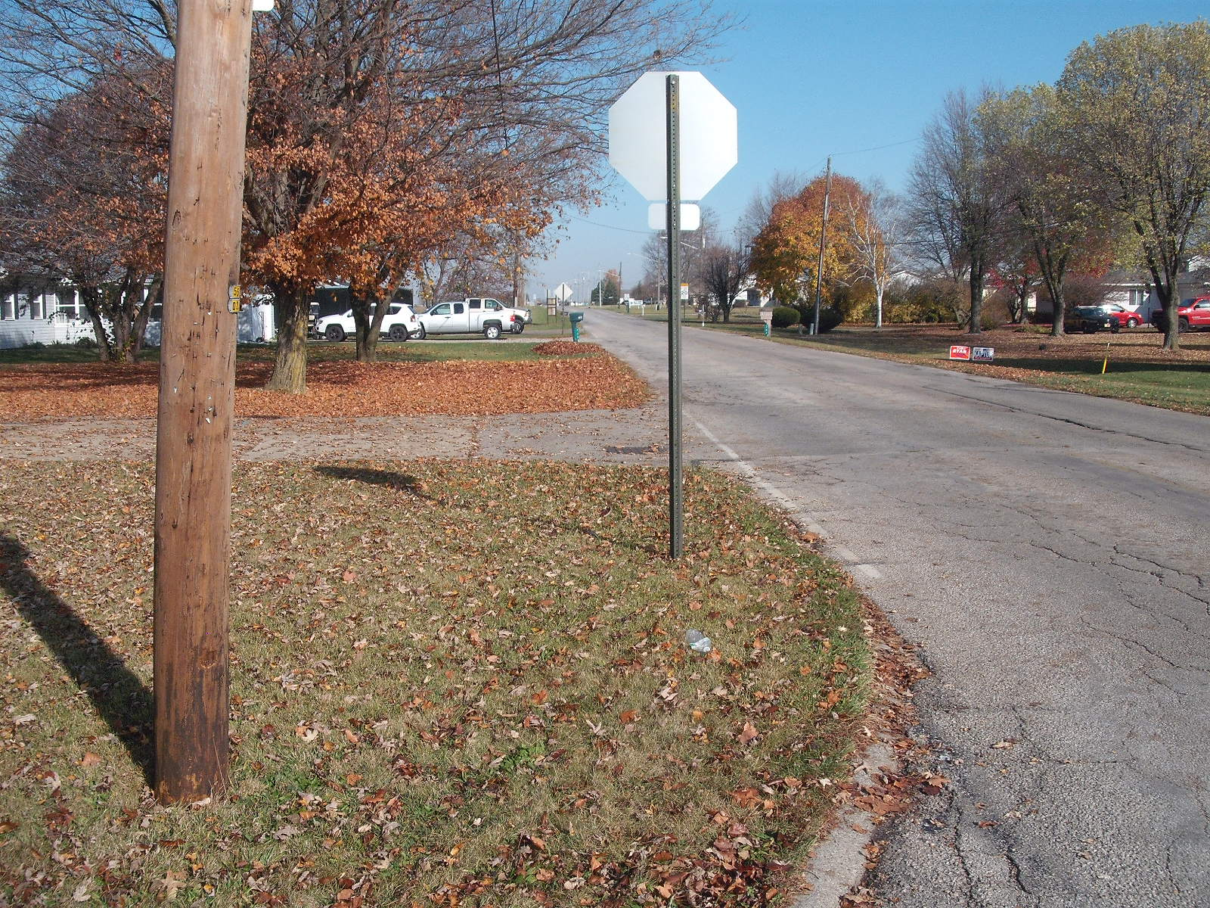
West side Taylor Street
Looking upstream

Slide 29
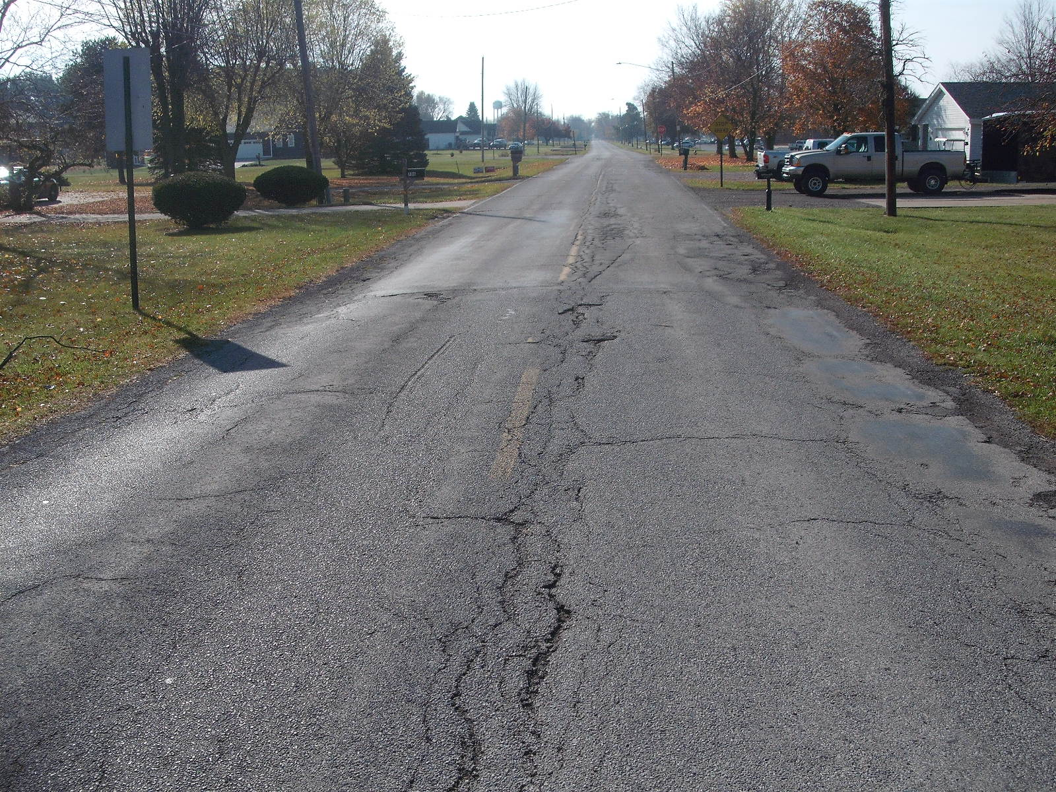
Taylor Street
Looking downstream

Slide 30
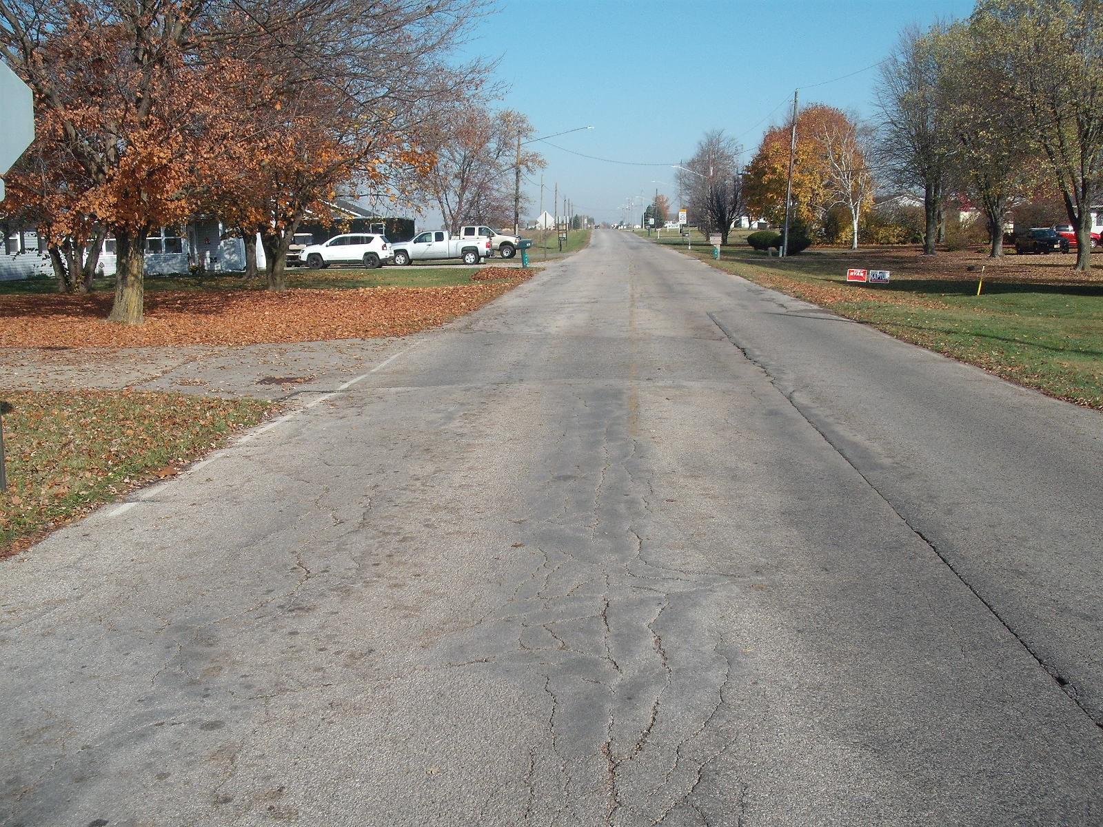
Taylor Street -
Looking upstream from Eastwood

Slide 31
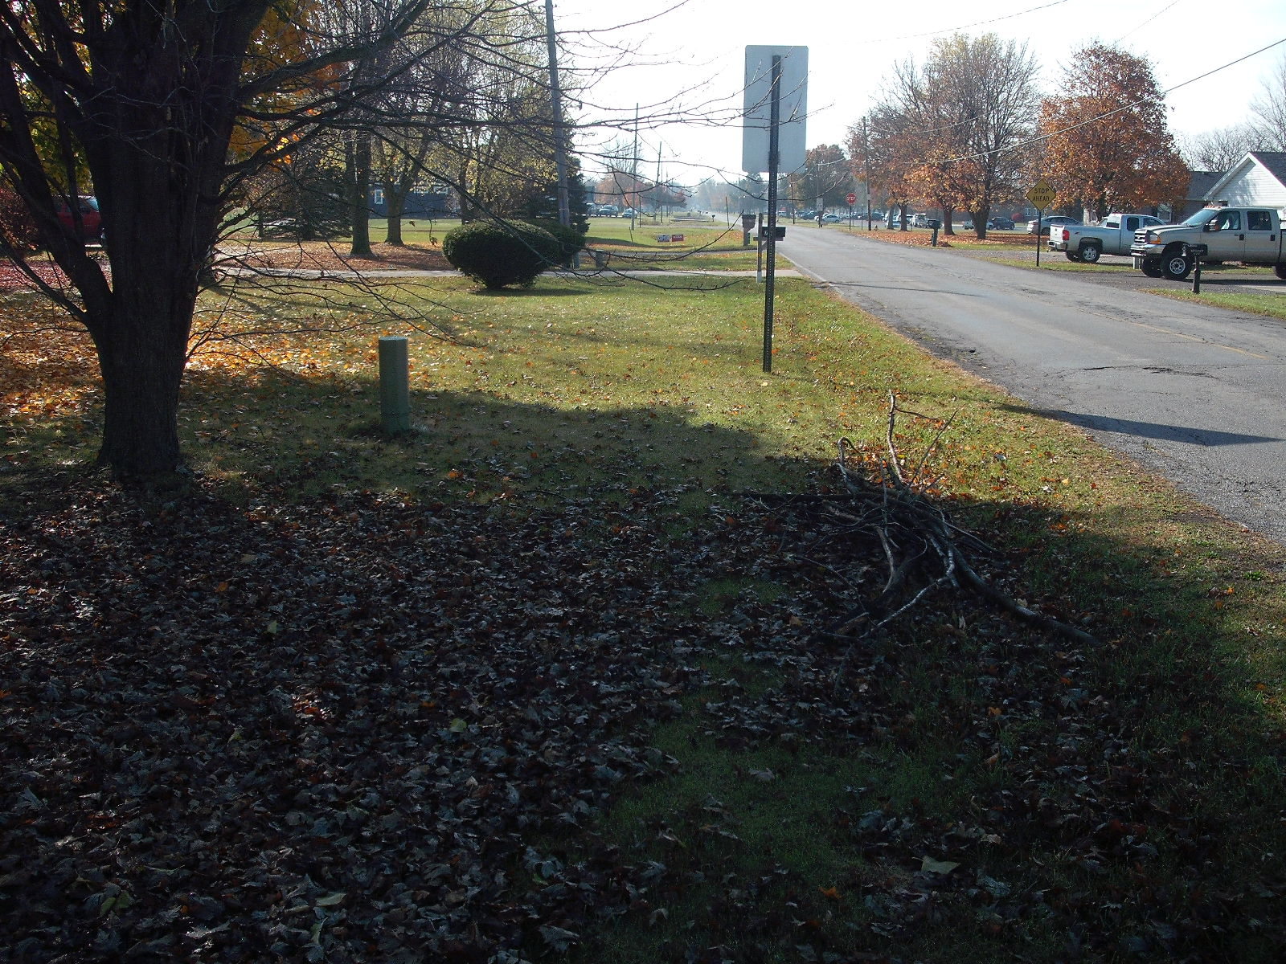
East side Taylor Street
Looking downstream

Slide 32
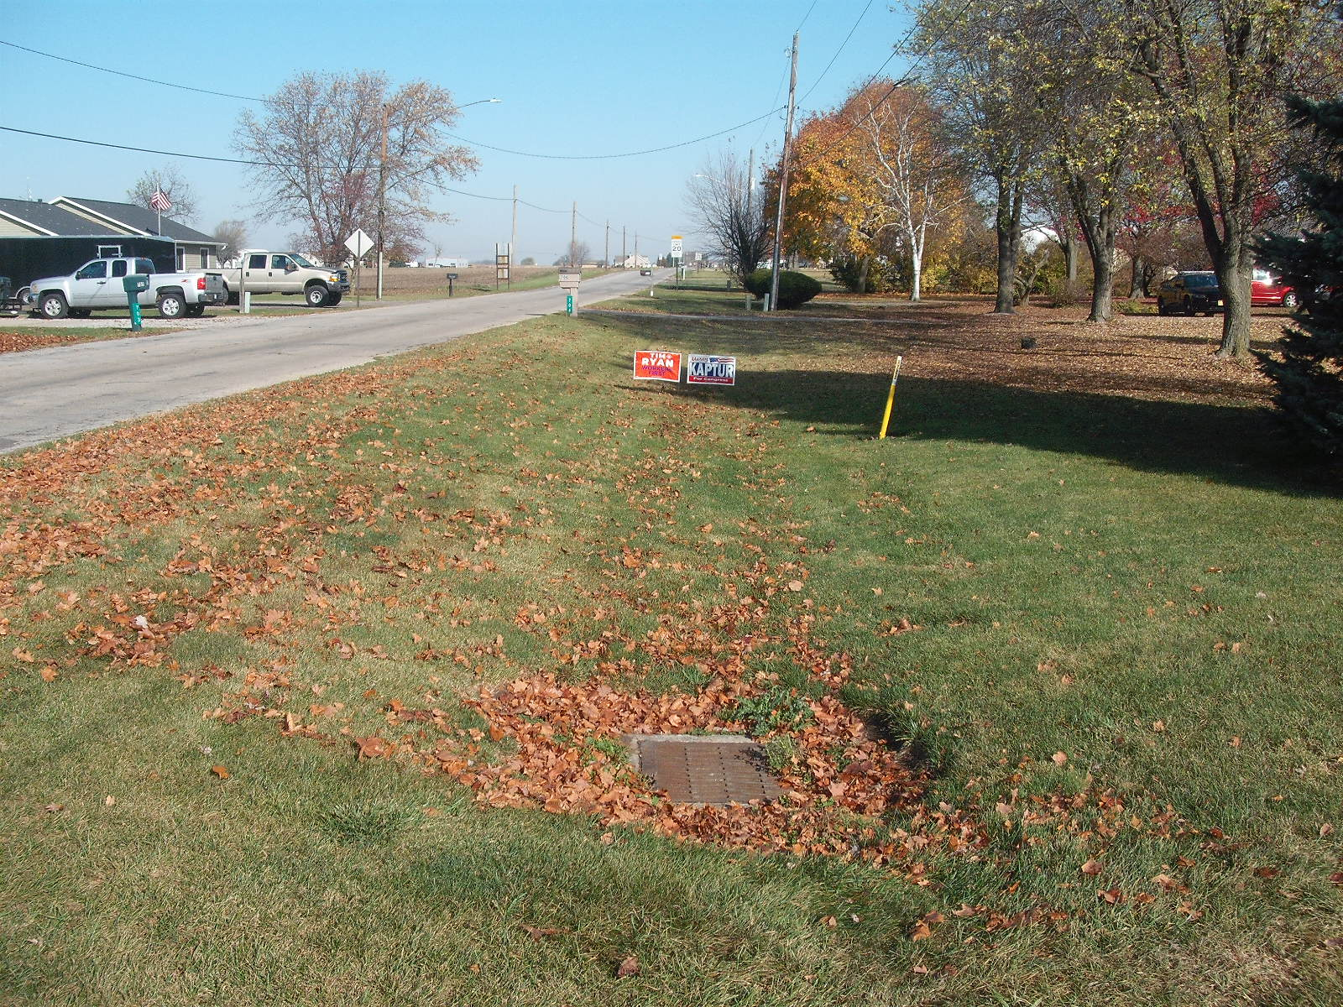
East side Taylor Street
Looking upstream

Slide 33
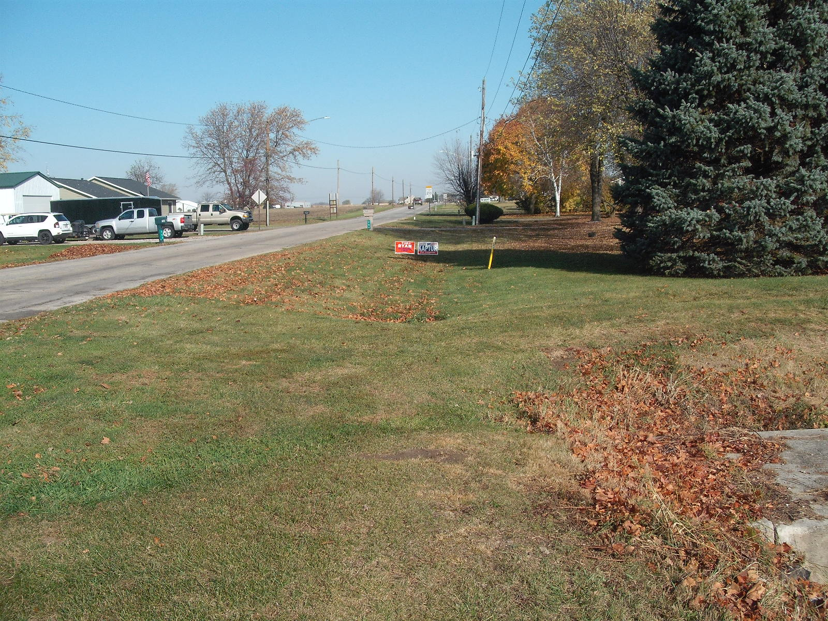
East side Taylor Street
Looking upstream from Fewless Creek

Slide 34
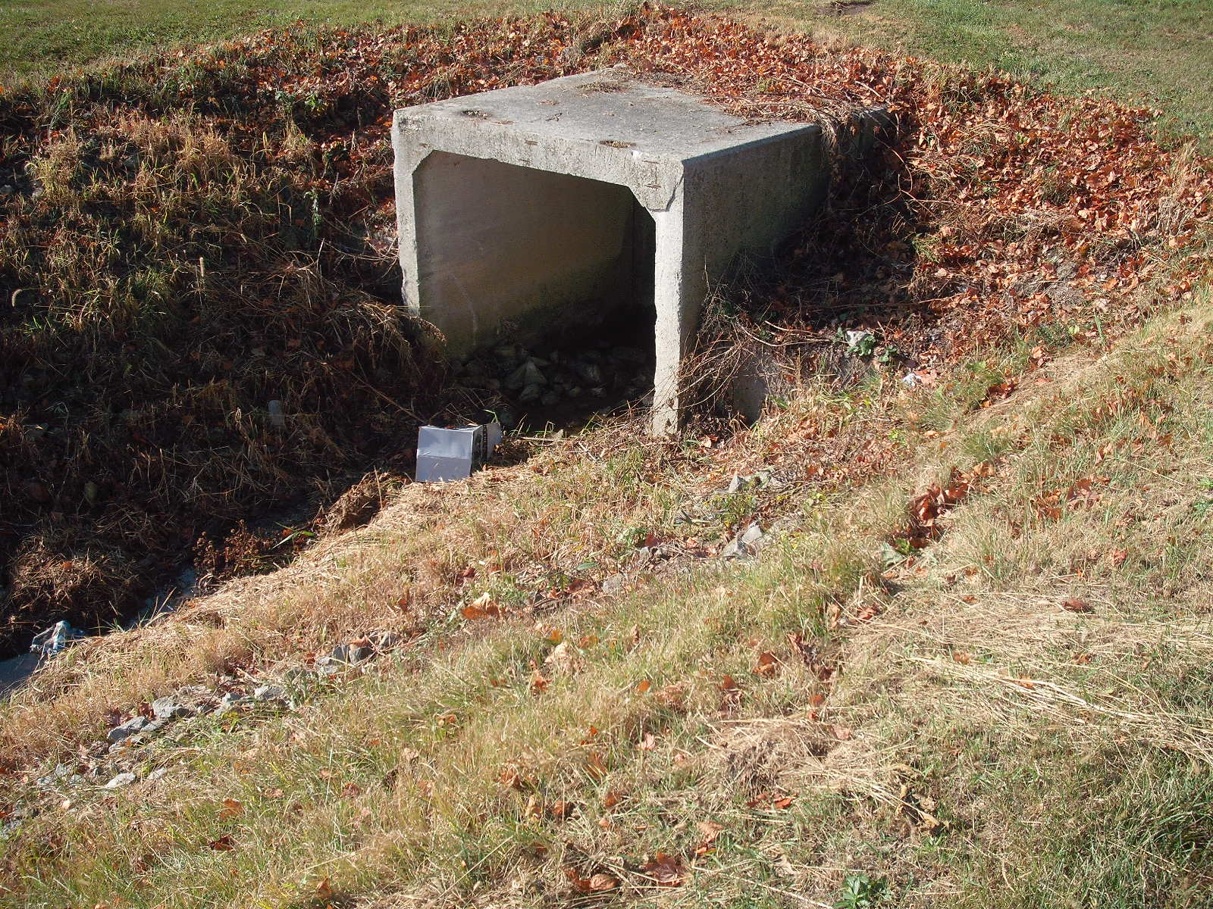
Inlet (East End) Fewless Creek
Box Culvert east side Taylor Street

Slide 35
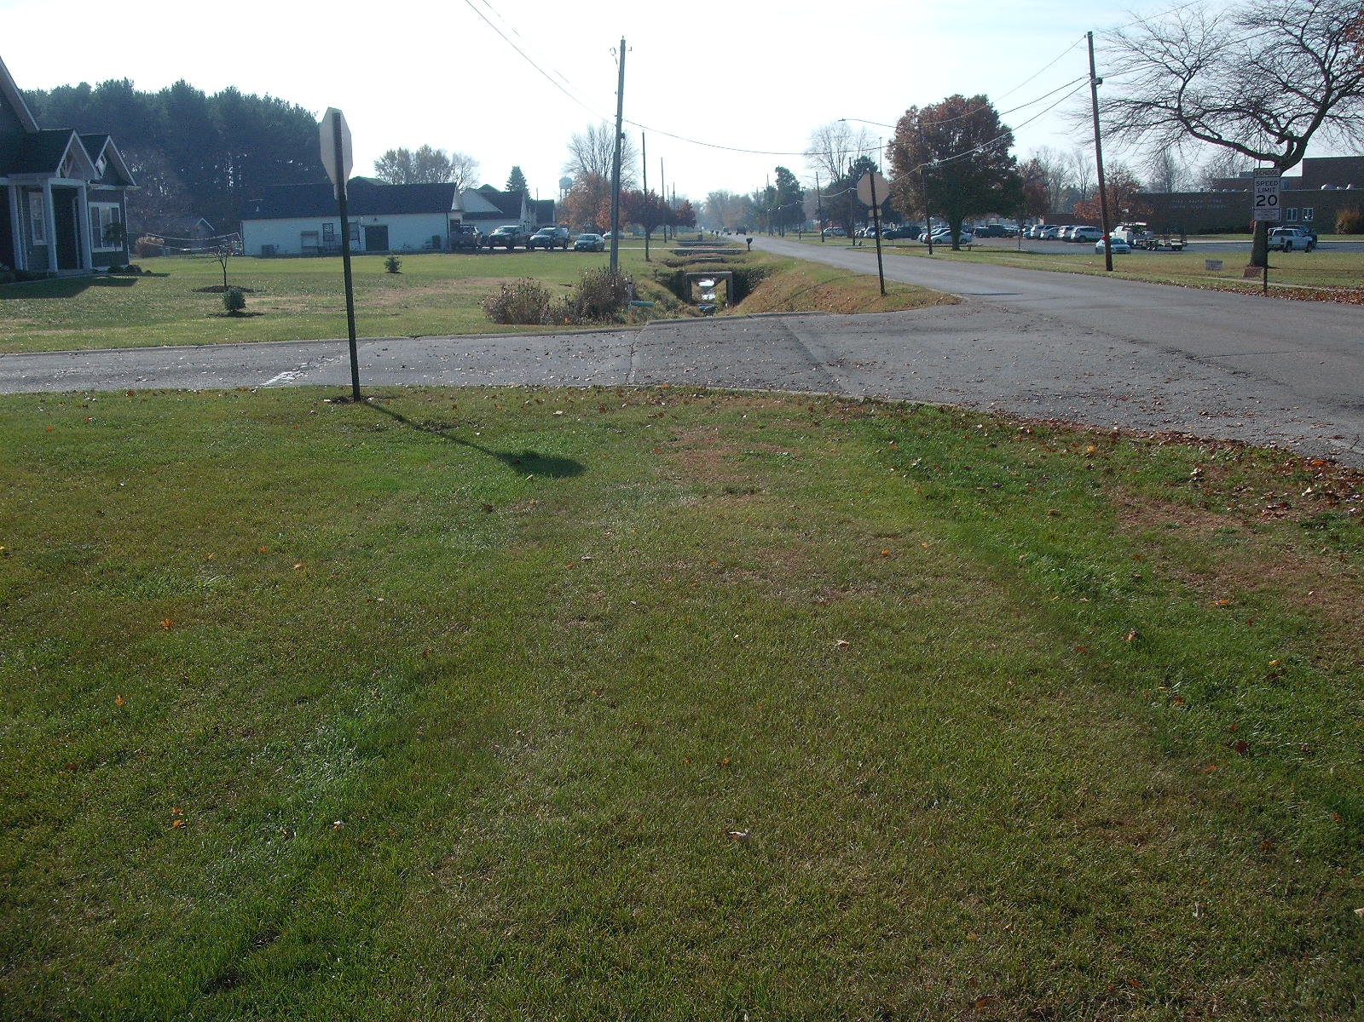
Over Box Culvert east side Taylor St.
Looking downstream to the South

Slide 36
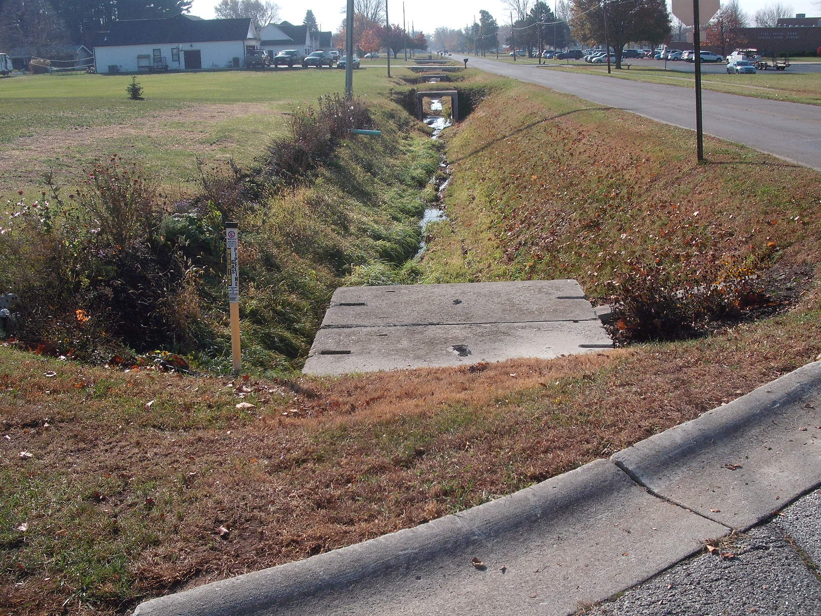
Outlet (South End) Fewless Creek Box Culvert east side Taylor Street

