Slide 1
Ditch No. 2148 Branch 4d Turkeyfoot Creek
A petition to repair or replace an existing tile outlet
installed in 1919 through Single County Ditch 1199

Slide 3
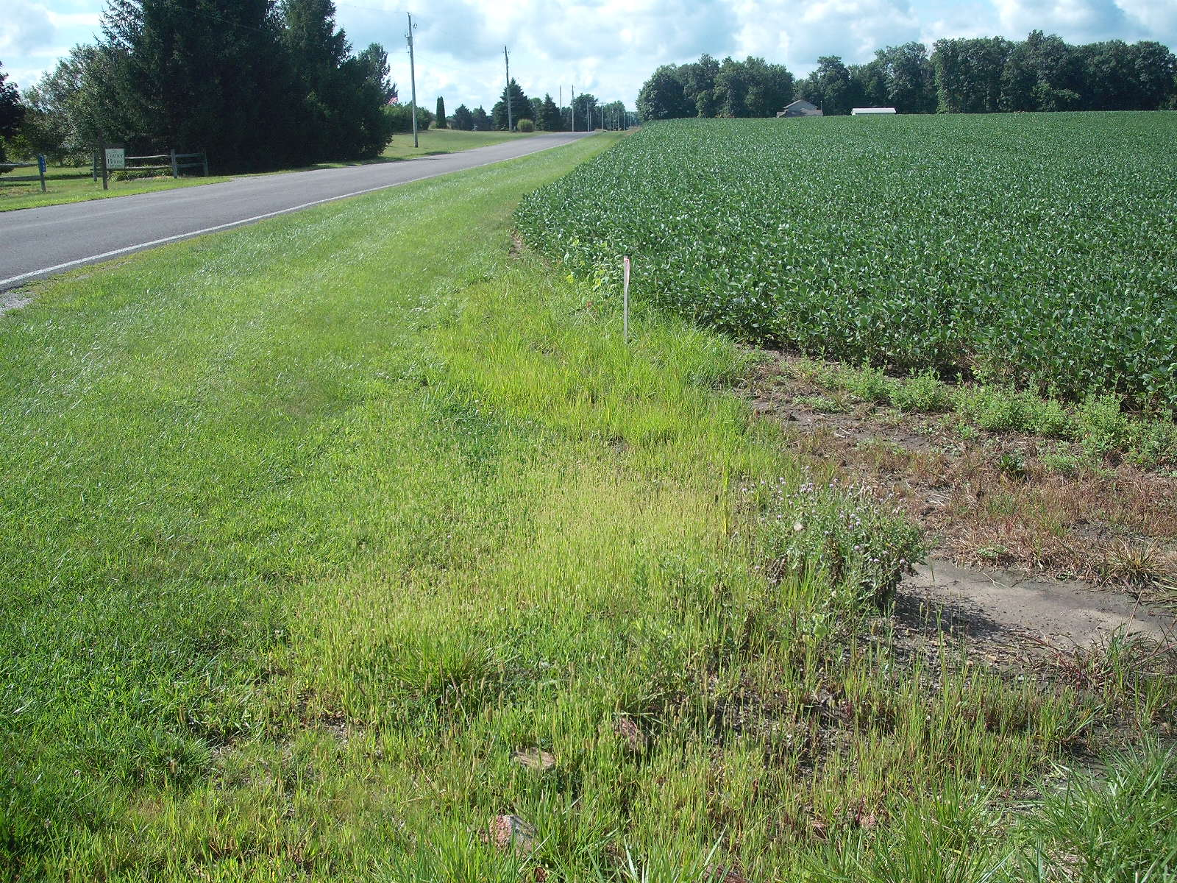
Upper Terminus Ditch 1199/2148

Slide 4
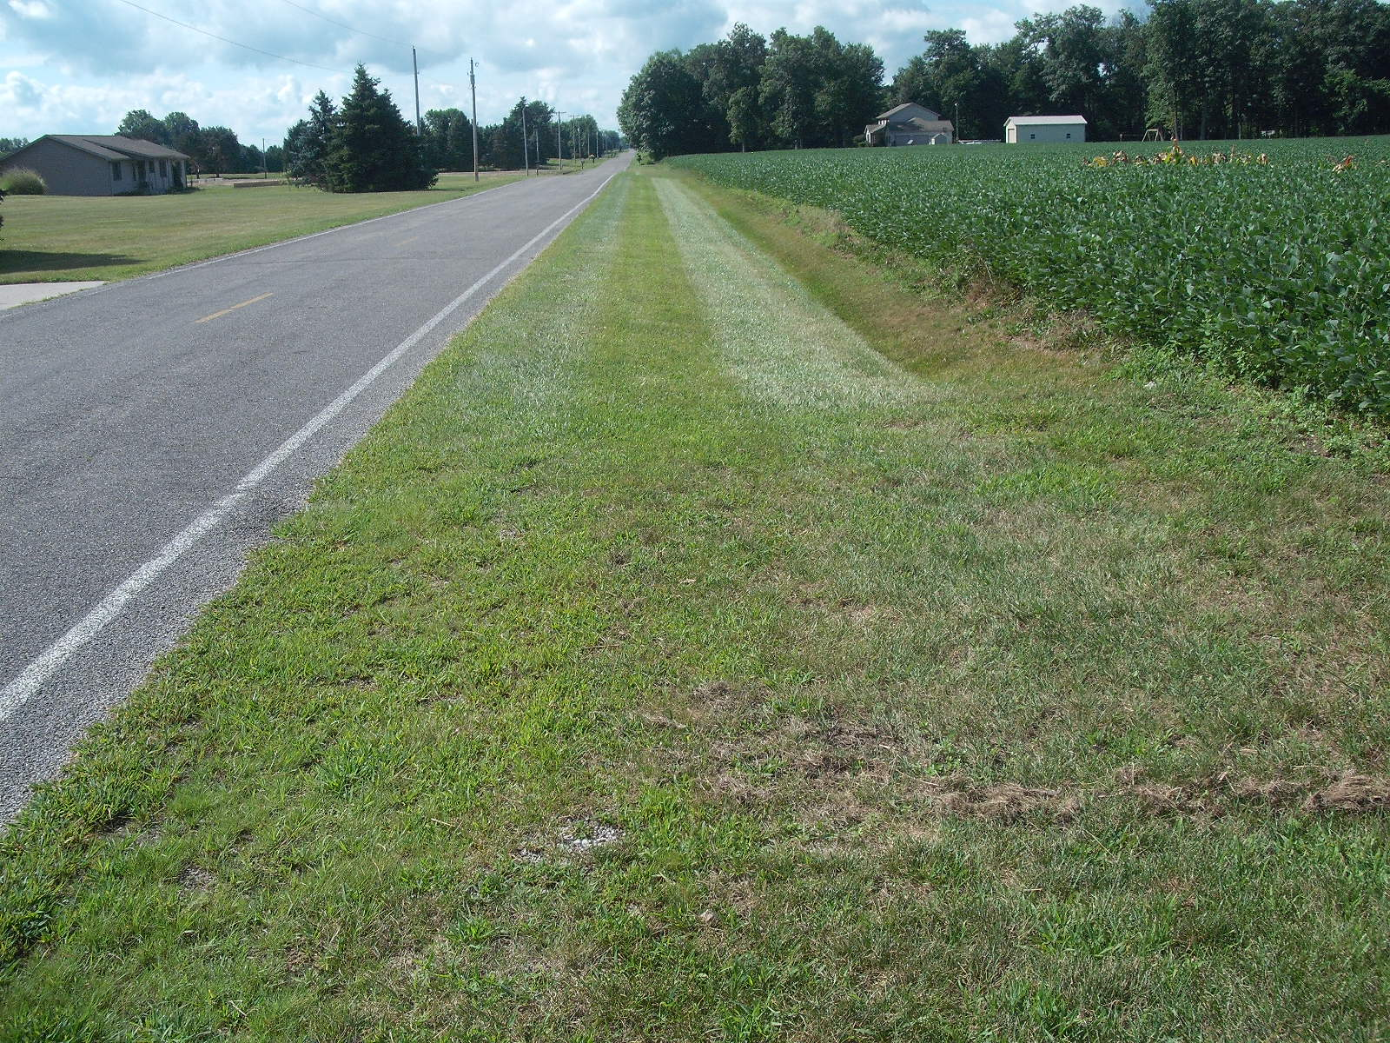
Along the route of Ditch 1199/2148 looking downstream

Slide 5
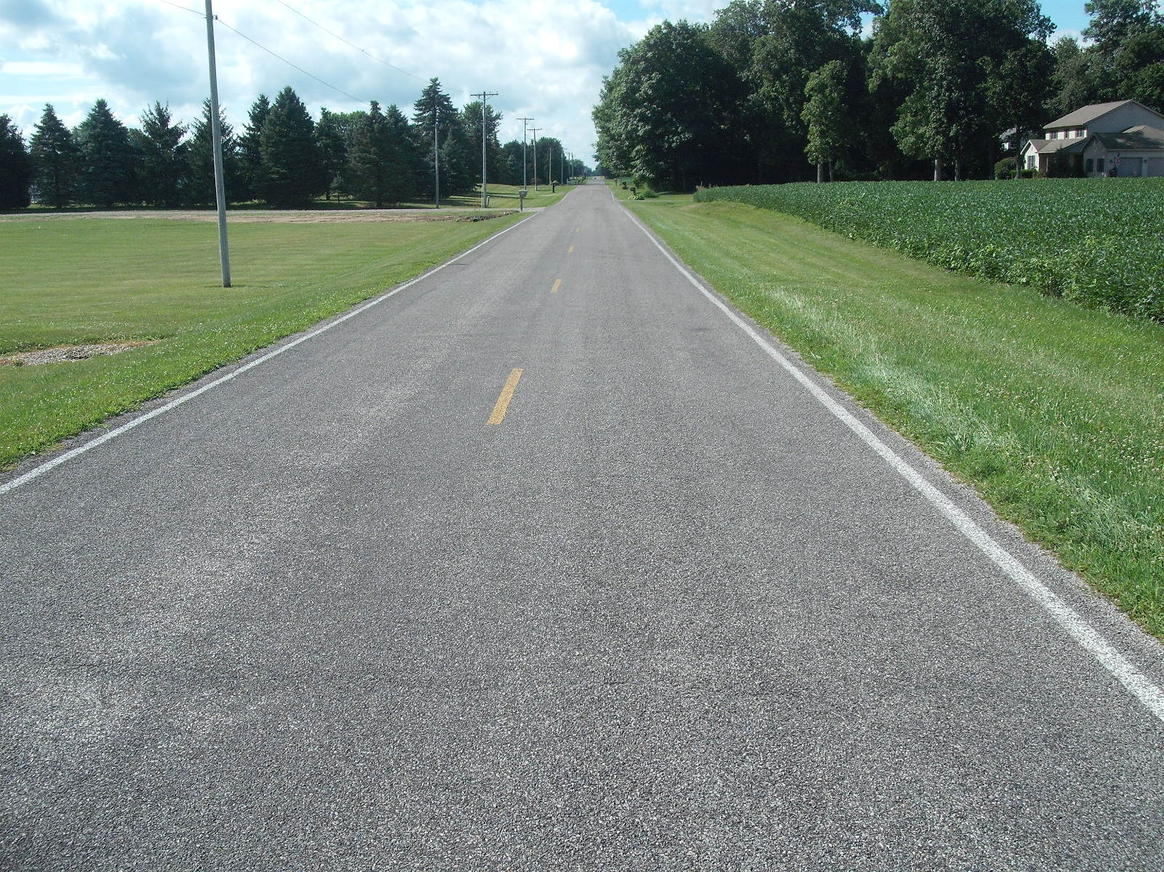
Along the route of Ditch 1199/2148 looking downstream

Slide 6
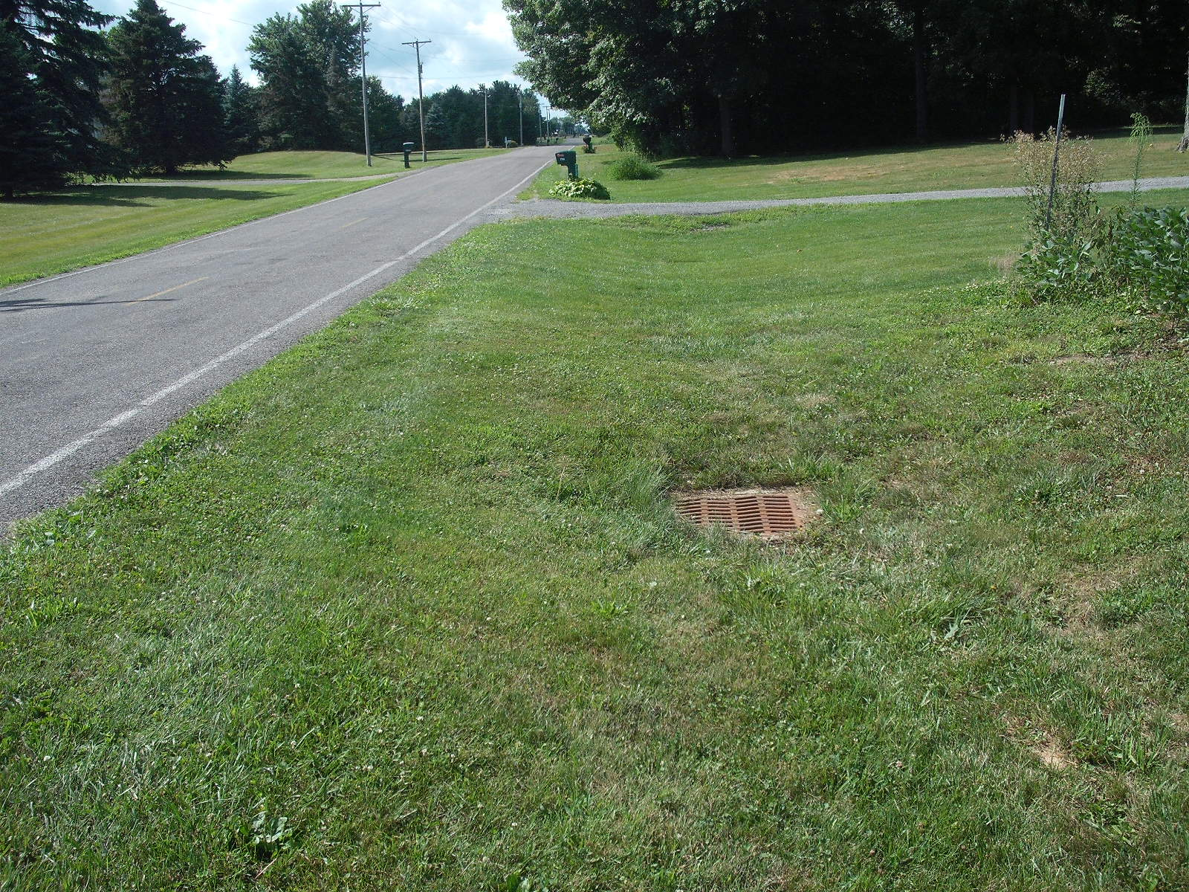
Along the route of Ditch 1199/2148 looking downstream Approaching 7721 Road 12

Slide 7
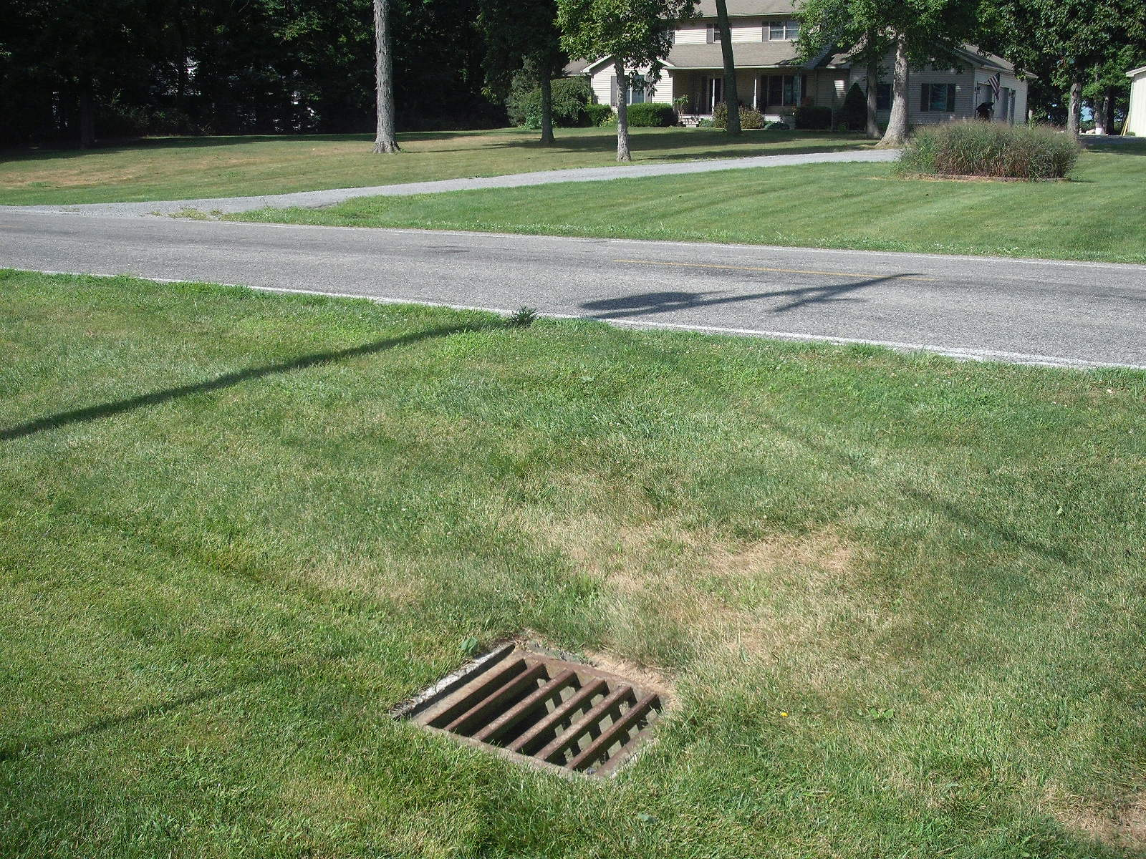
Cross over to main tile

Slide 8
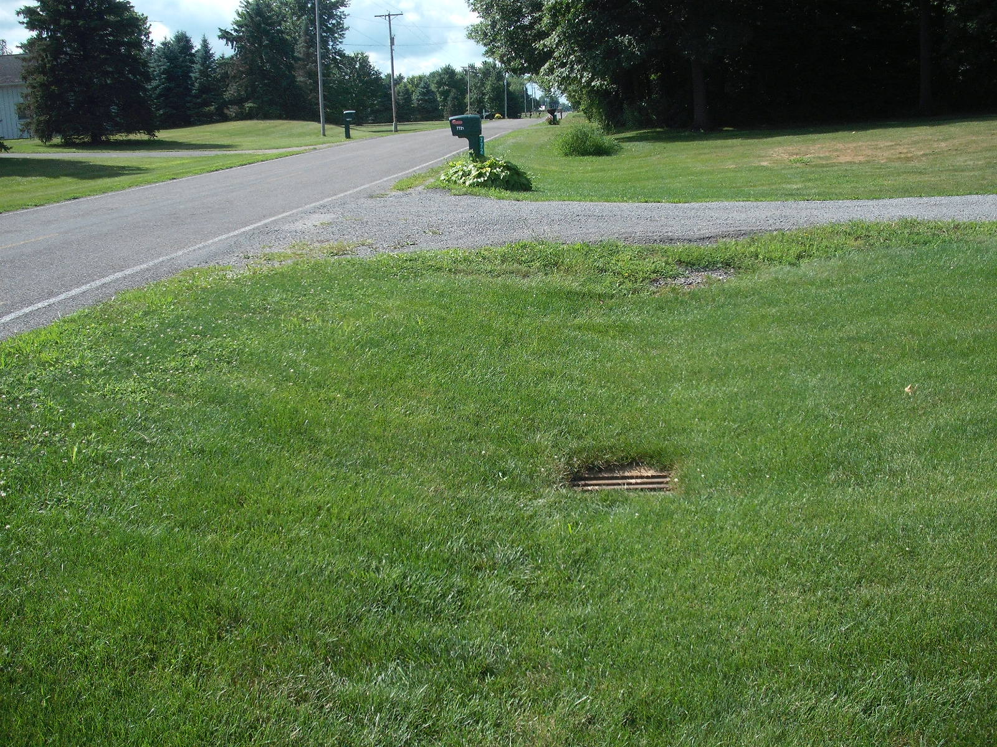
Along the route of Ditch 1199/2148 looking downstream Catch basin on main tile at 7721 Road 12

Slide 9
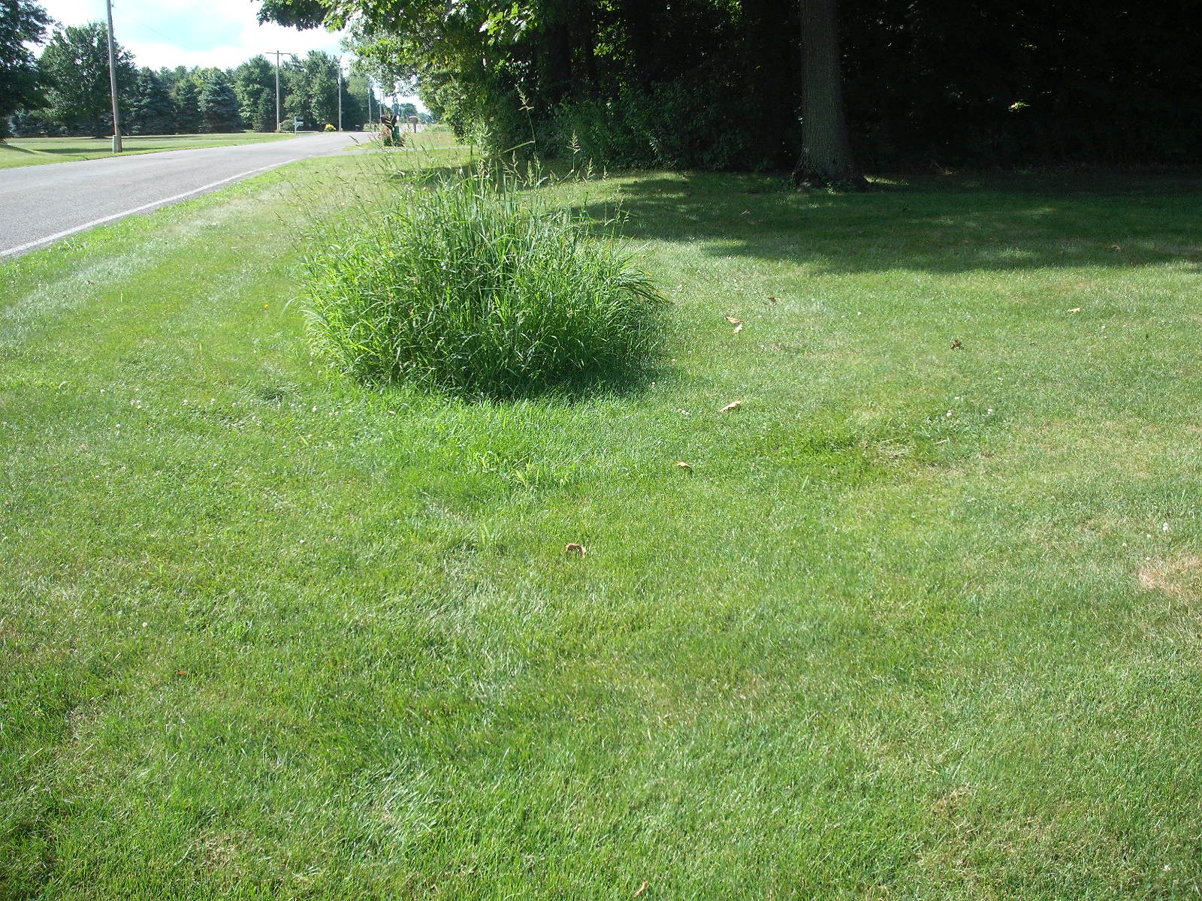
Along the route of Ditch 1199/2148 looking downstream
Wet area over main tile at 7721 Road 12

Slide 10
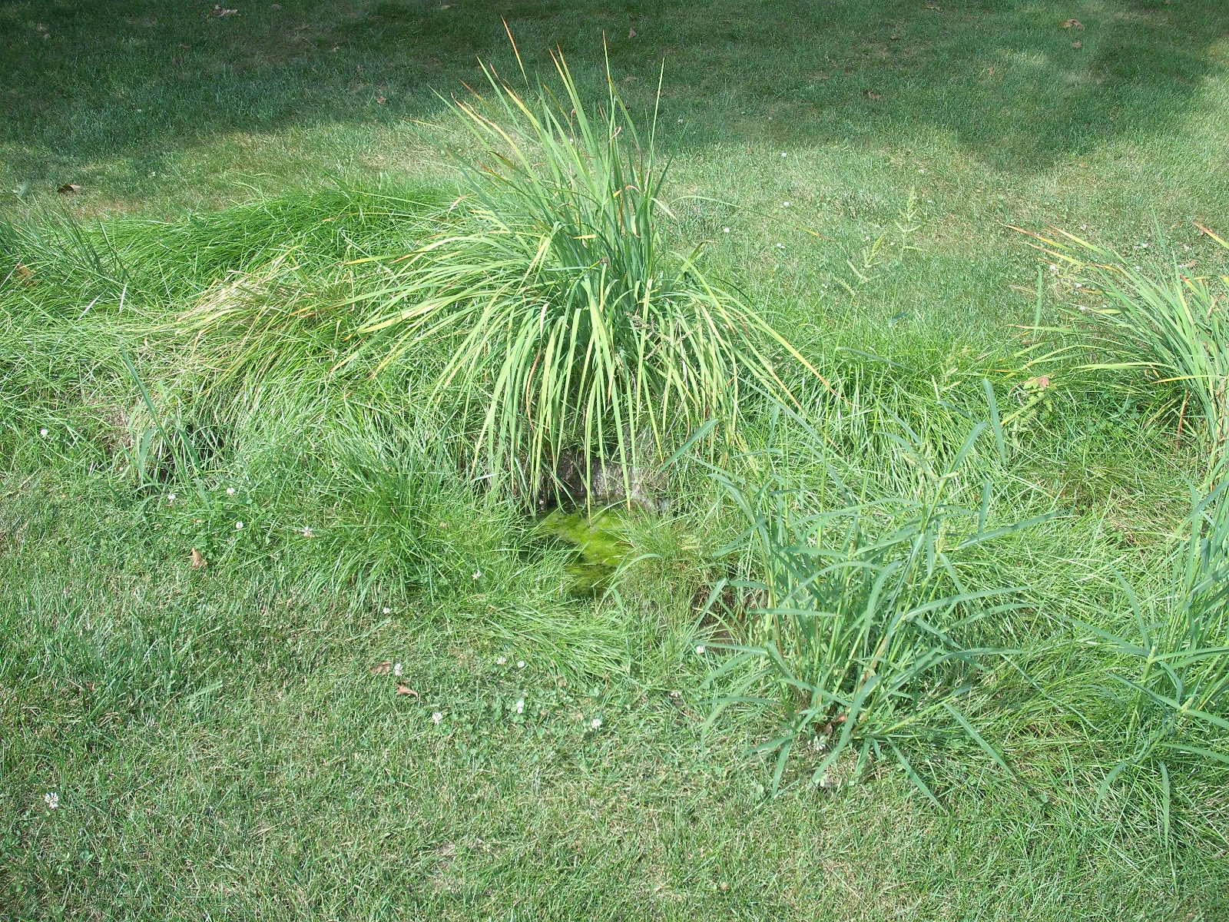
Along the route of Ditch 1199/2148
Wet area over main tile at 7721 Road 12

Slide 11
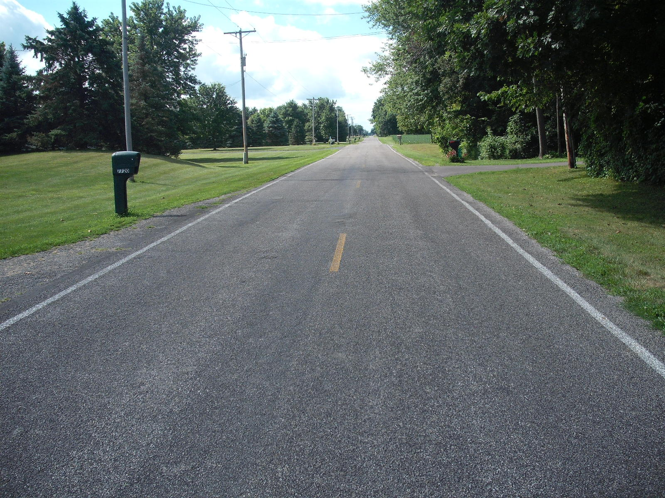
Along the route of Ditch 1199/2148 looking downstream
In front of 7707 Road 12

Slide 12
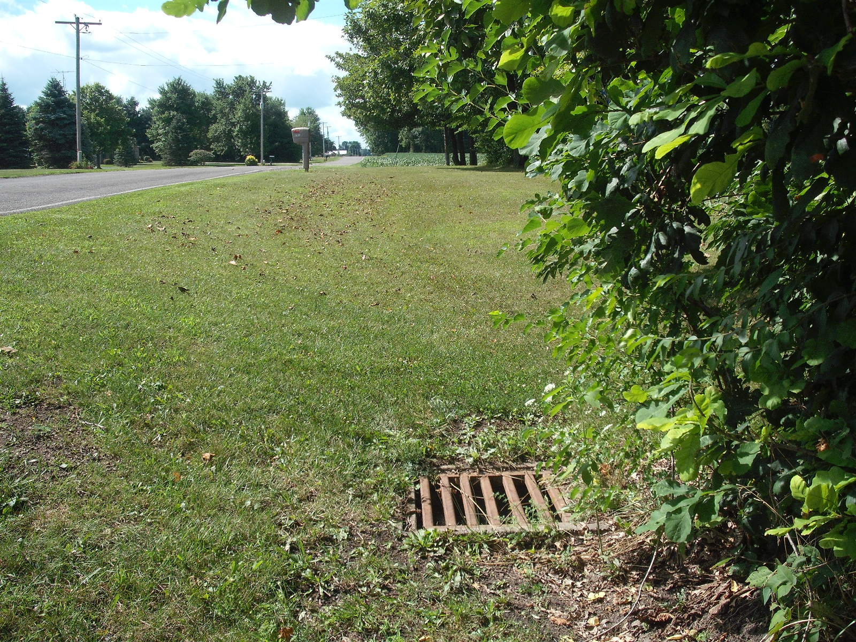
Along the route of Ditch 1199/2148 looking downstream
Near 7671 Road 12

Slide 13
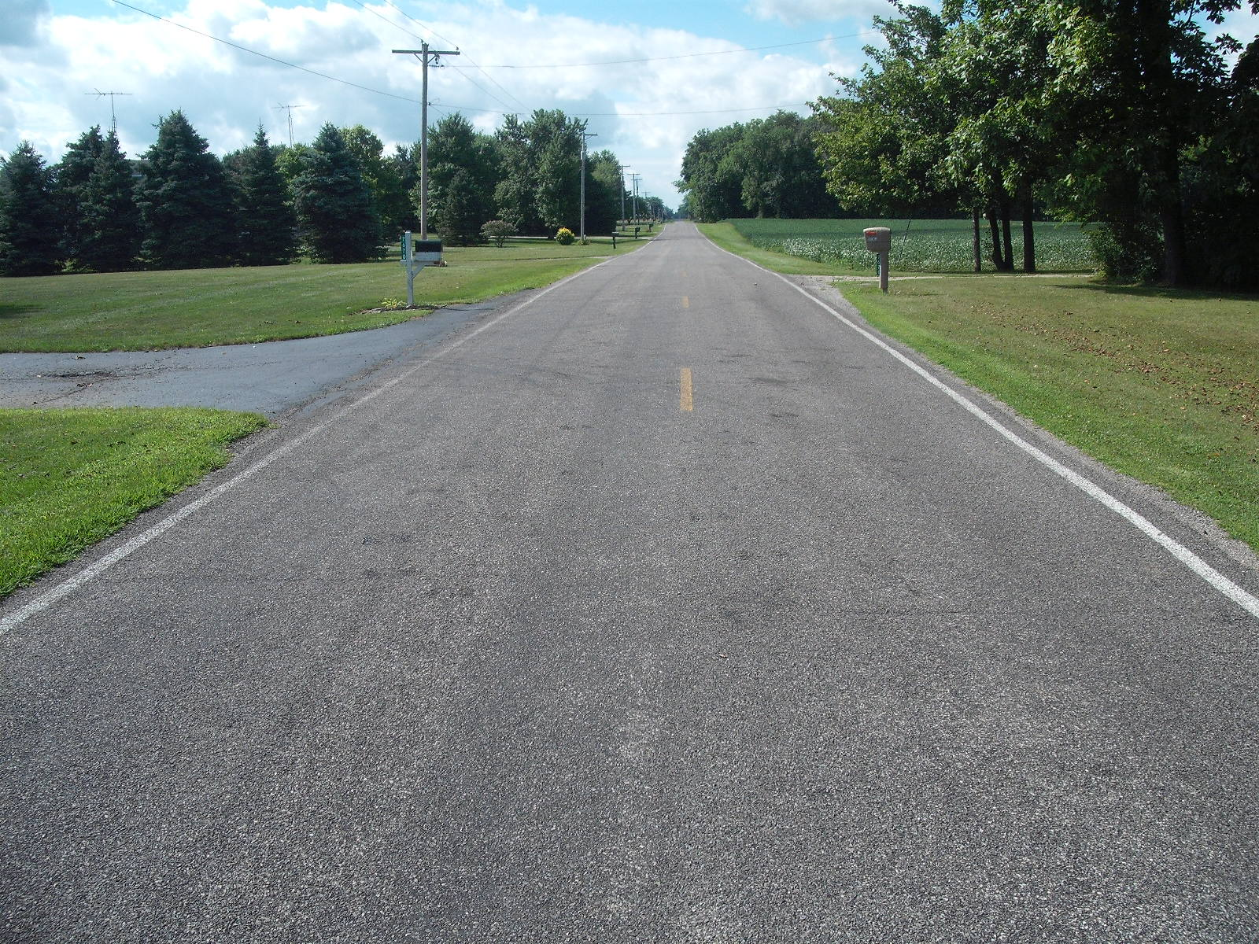
Along the route of Ditch 1199/2148 looking downstream In front of 7670 and 7671 Road 12

Slide 14
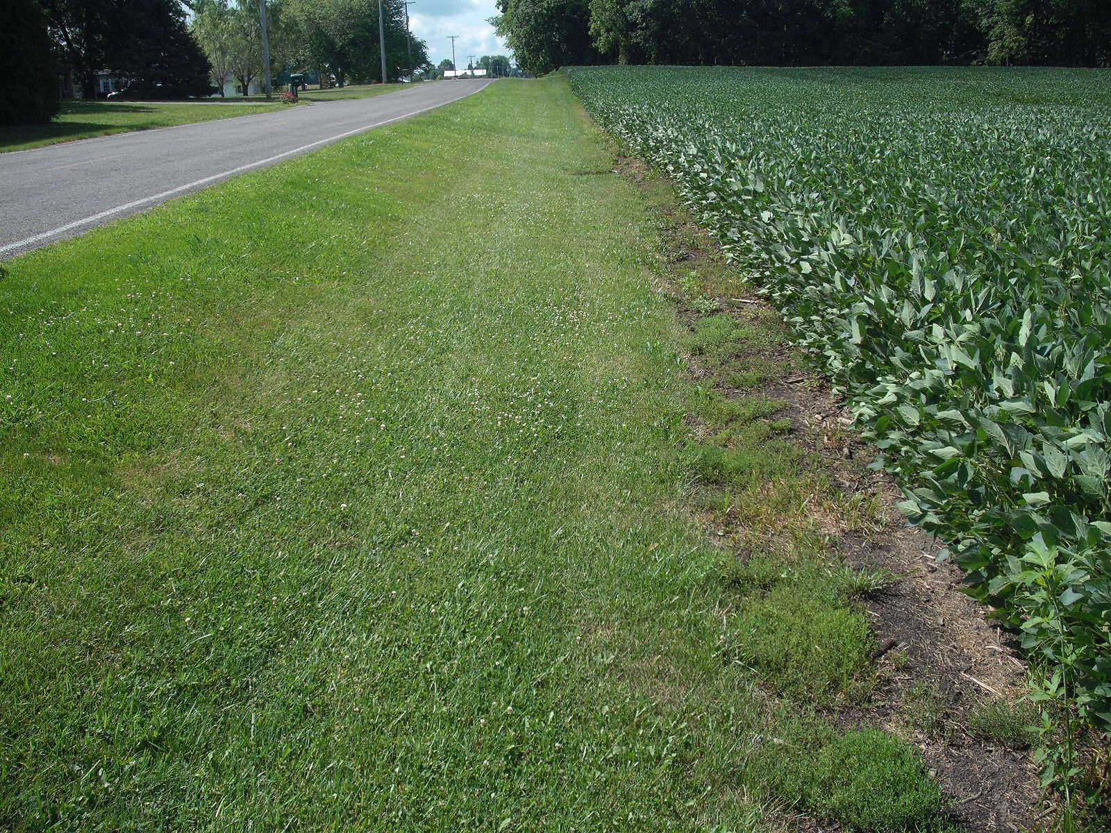
Along the route of Ditch 1199/2148 looking downstream

Slide 15
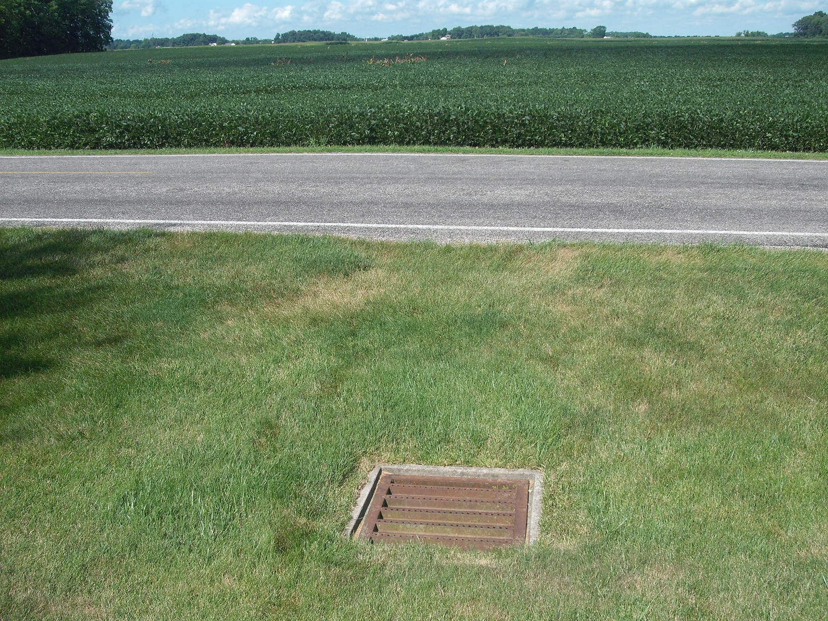
Cross over to main tile in front of 7580 Road 12

Slide 16
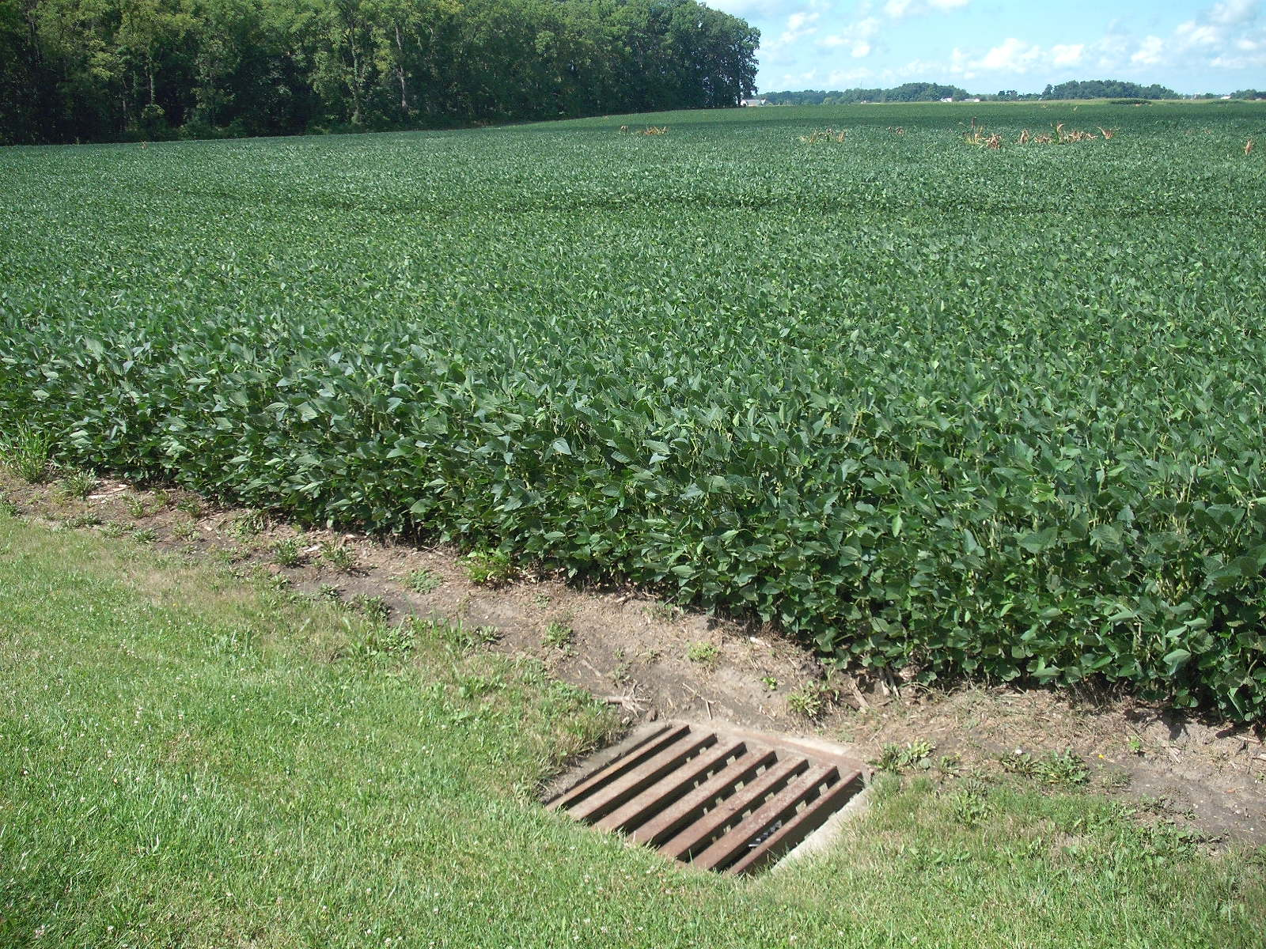
Main tile leaves Road 12 R/W crossing the
Roger & Dawn Lane farm to the southwest

Slide 17
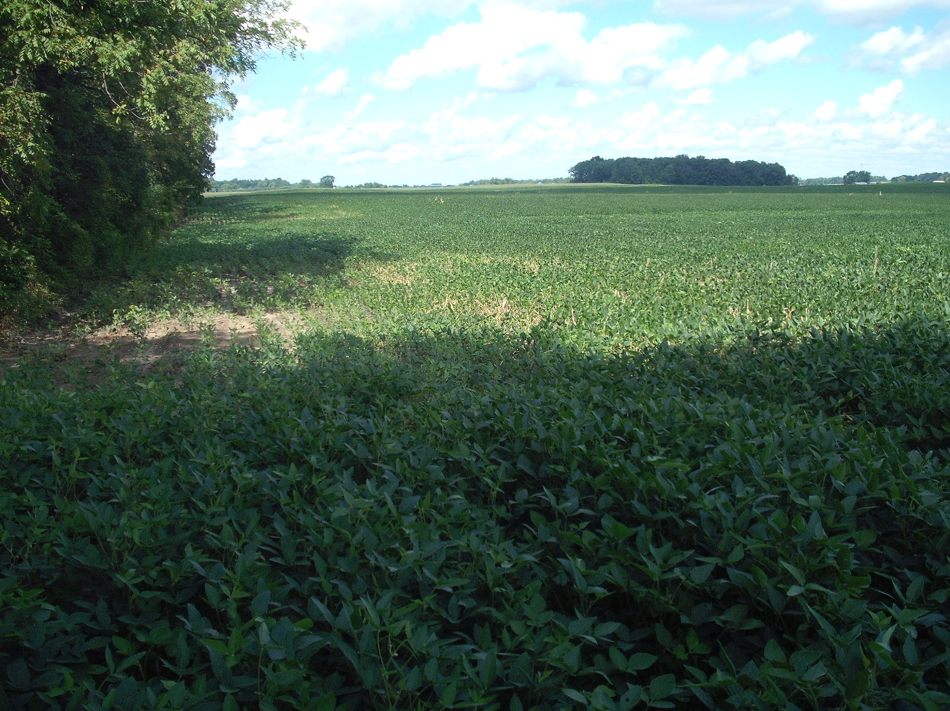
Lane farm where main tile enters the Elton property

Slide 18
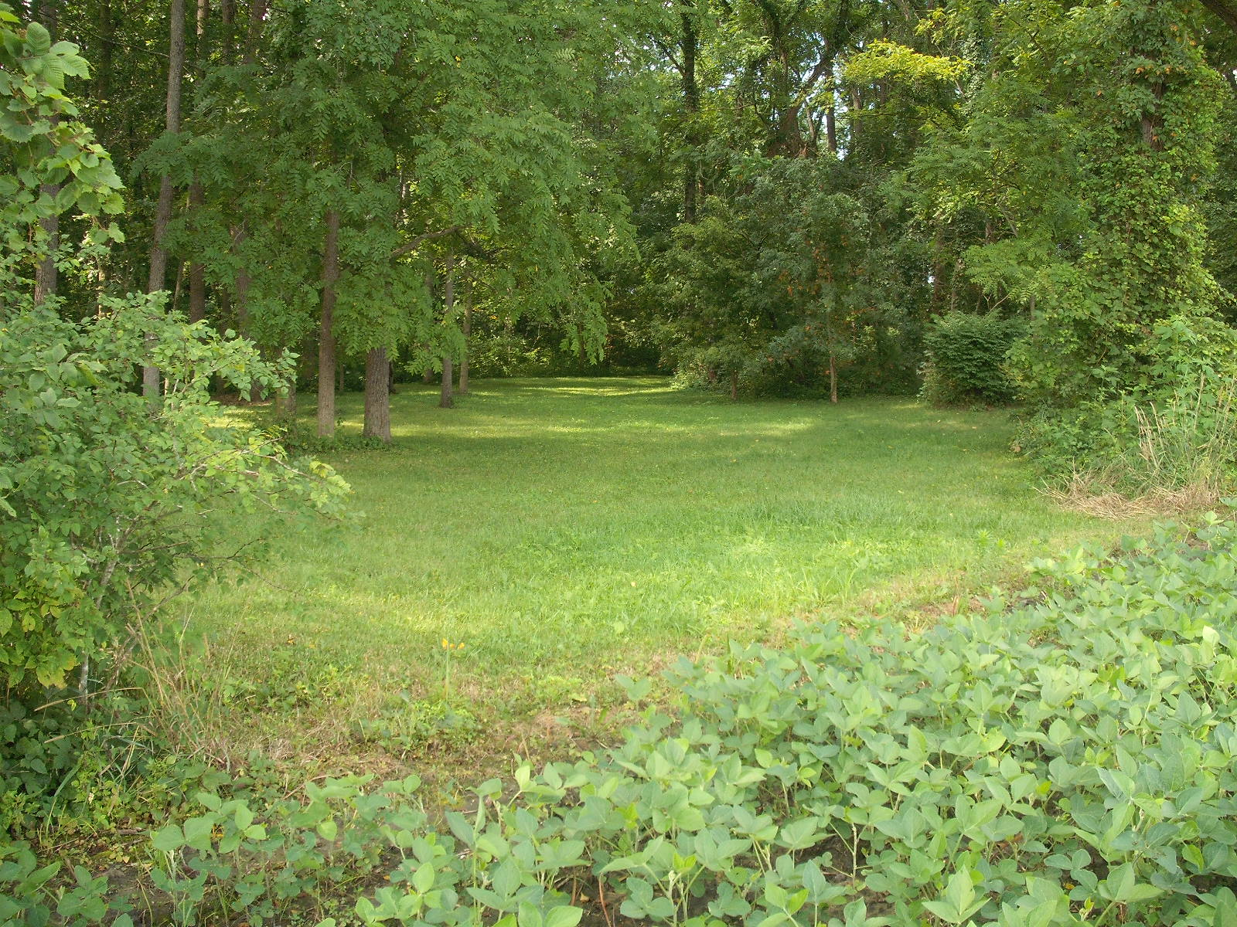
Over the main tile through Elton’s woods

Slide 19
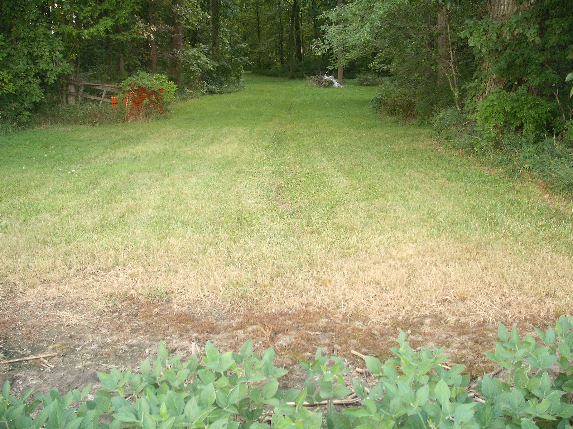
Over the main tile where it leaves Elton’s woods

Slide 20
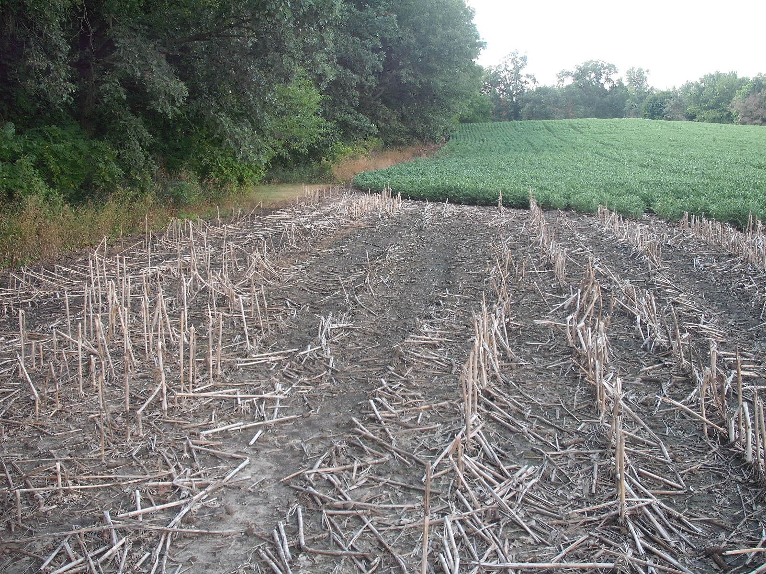
Prevented planting on Neuenschwander
near where the main tile leaves Elton’s woods

Slide 21
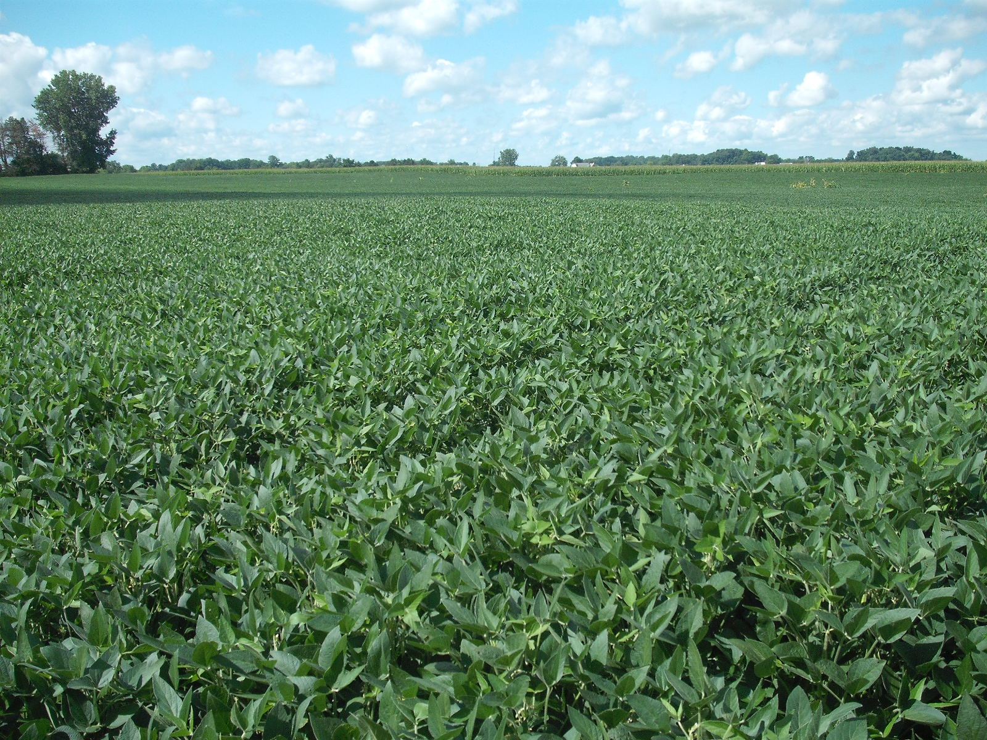
Main tile continues to the southwest across Neuenschwander
for another 2,200 L.F. to its outlet at Br.4 Turkeyfoot Creek

